Slide 1
The Importance of Trusts
Special guest +
Richard Coulson

Slide 2
Today’s Agenda
Vincent O’Connor – Royal London
Richard Coulson

Slide 3
OSAD / 501
Daily
25pm
50pm
100pm
4001 200pm
5000pm!!!

Slide 4
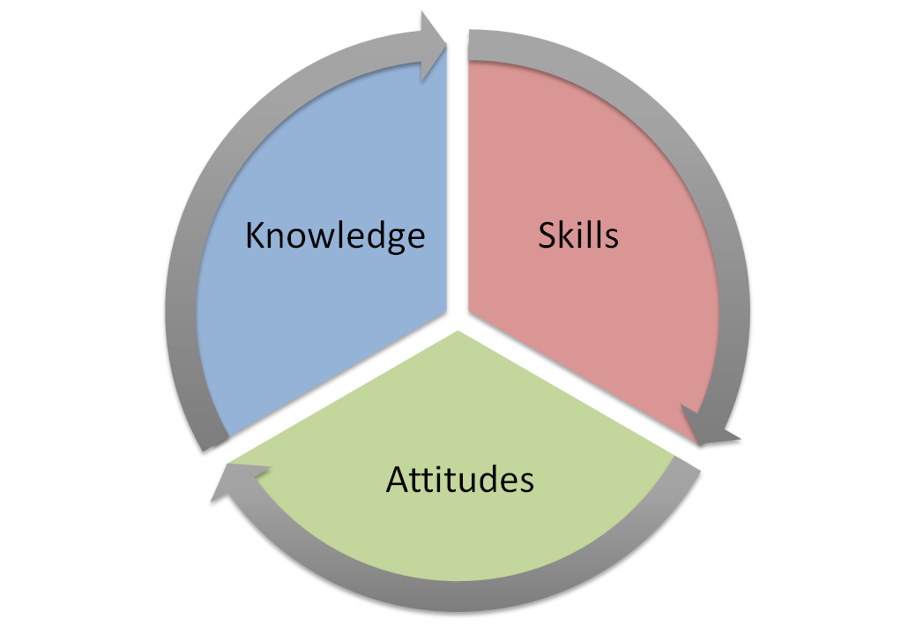
The ASK Model
Cancer, Heart Attack, Stroke
Sickness, Accident, Disability
Death
Trusts
Wills

Slide 5
Money Maze
INCOME GROSS | INCOME NET | LIABILITIES/DEBTS
DEATH | CANCER | SICKNESS / ACCIDENT
BUILDINGS AND CONTENTS | SAVINGS | STOP WORK
£3,100pm
£2,000pm
£5,100pm
Mort Halifax £150k - £500pm 25 yrs
Car
Loan - £275 – Nov 2020
CCs - £100
£50kpa
£30kpa
X4
x2
Trust –
3 referrals
£95.85pw
Deadline to Breadline – L and G
£6,000
64
62
Upgrade or rebalance your portfolio
Specialise in B and C
We will sort that for you
WILL x 3 referrals
Notes:
Introduce the money maze and work through it.

Slide 6
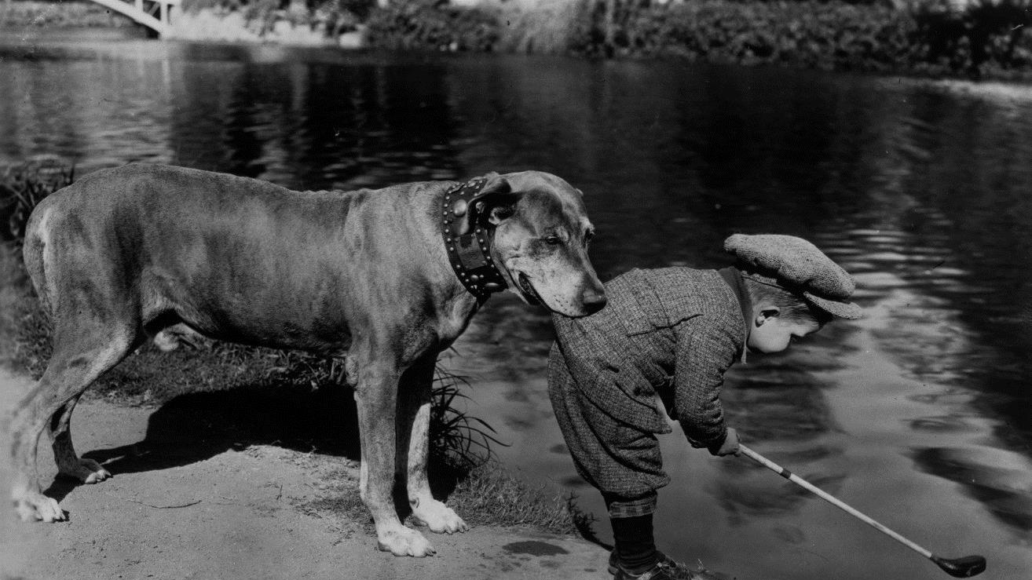
It’s all about
Trust!
Notes:
hello

Slide 7
It’s all about trust
Agenda
Quick technical round-up
The trust disclaimer and treating customers fairly (TCF)
Benefits to your business
Avoiding delays
What good looks like
The Royal London solution
Notes:
We’ve got 2 main learning objectives from this session today.
At the end of this presentation, you’ll have a greater understanding of how to use the Royal London Marketing Studio. This is a whole suite of tools and marketing materials you can use within your own business to promote the idea of protection and deal with common client objections.
And then I’ll just give you an overview of an exciting upgrade we’ve made to our Critical Illness Proposition

Slide 8
It’s all about trust
Learning objectives
At the end of this presentation, you should:
Understand the business opportunities of making trusts a key part of your protection proposition
Have a wider understanding of what happens in the probate process and why this takes months to complete
Accurately be able to locate and complete a Royal London trust form for a protection policy
Describe the importance of the letter of wishes and why this should be reviewed periodically

Slide 9
Quick technical
round-up

Slide 10
It’s all about trust(s)
Quick technical round-up
The person(s) who set up the life policy and write it into trust are known as the Donor(s)
Joint life policies should be written into a trust with a specific Survivorship clause
Policies which include Critical Illness Cover should be written into a Split Trust
?
?
?

Slide 11
It’s all about trust(s)
Quick technical round-up
The Trustees are the legal owners of the trust fund (initially the plan)
The trustees hold the trust fund for the benefit of the Discretionary Beneficiaries
If you don’t want to be able to change your beneficiaries in the future, you should use a Bare Trust
?
?
?

Slide 12
It’s all about trust(s)
Quick technical round-up
When writing a policy into trust, the donor can guide the trustees about who should receive the policy proceeds and in what proportion – using a Letter of Wishes
61% of UK adults don’t have a valid will in place*.
?
%
*Source : Report by the Kings Court Trust: A Changing Landscape –
The Will Writing Industry in 2017, accessed March 2020.

Slide 13
Trust
Disclaimer?

Slide 14
It’s all about trust(s)
The disclaimer
I understand that contrary to the advice by my protection adviser, I do not wish to write my life insurance policy into trust
I understand this means…
My beneficiaries will have a delay in receiving any proceeds from my policy
Payment from my life policy could go to the wrong people
My policy proceeds could be subject to an inheritance tax charge of 40%
Client signature
If you were the client,
would you sign this?
Date of signature

Slide 15
It’s all about trust(s)
The ultimate TCF?
What would the ultimate TCF look like?
Protection policy
Making sure that there are no DELAYS in
payment from single life policies
Avoiding INHERITANCE TAX
on the policy proceeds
Making sure payment goes to the
CORRECT PEOPLE

Slide 16
It’s all about trust(s)
The benefits to my business…
Demonstrates higher quality advice
Policies are more difficult to
re-broke by other advisers
Is an opportunity for referrals
Differentiates you from
‘other advisers’
Business is more persistent
Helps you set up future review opportunities
Allows for better client engagement
Protects your business

Slide 17
Delays in
Payment

Slide 18
It’s all about trust(s)
When someone dies…delays?
When someone dies…
Notify death to Register Office (within 5 days)
Arrange funeral
Contact relevant institutions
Source: www.gov.uk/when-someone-dies. Accessed March 2020.
Notes:
8 days for notification of death in Scotland

Slide 19
It’s all about trust(s)
When someone dies…delays?
When someone dies…
Notify death to Register Office (within 5 days)
Arrange funeral
Contact relevant institutions
Employer
Pension provider
Utility companies
Relatives
Council office
Investment providers
Friends
Passport office
Credit card providers
Bank
DVLA
Dept Work & Pensions
Building society
HMRC
Mortgage company
Contact solicitor
Find the will
Apply for probate
Source: www.gov.uk/when-someone-dies. Accessed March 2020.
Notes:
8 days for notification of death in Scotland
https://www.gov.uk/when-someone-dies

Slide 20
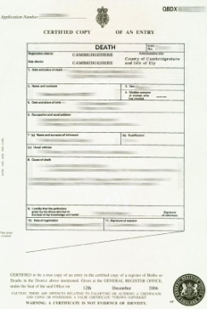
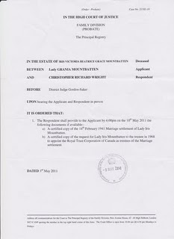
It’s all about trust(s)
When someone dies…delays?
When someone dies…
Notify death to Register Office (within 5 days)
Arrange funeral
Contact relevant institutions
Contact life insurance company, register claim
Claim form
Death
certificate
Grant of
probate
✓
✓
✗
Notes:
8 days for notification of death in Scotland

Slide 21
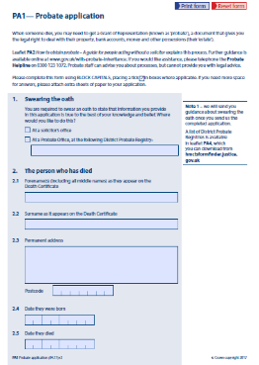
It’s all about trust(s)
Probate process - application
What forms do I need?
Probate (confirmation in Scotland) is a necessary legal process that is required before a deceased's assets can be distributed in accordance with their will
PA1P
Application for probate
For those who die intestate (without a will) the process requires a similar application process – using form PA1A
Source: gov.uk – Probate forms and guidance. Accessed March 2020 - link
Notes:
8 days for notification of death in Scotland

Slide 22
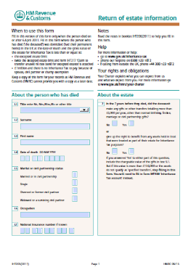
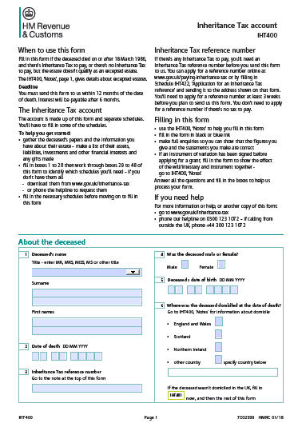
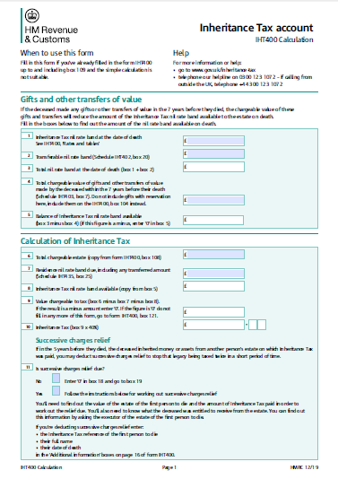
It’s all about trust(s)
Probate process - application
What forms do I need?
PA1P Application for probate
IHT 205 Return of estate information
IHT 400 Inheritance tax account
IHT 400 Inheritance tax calculation
All relevant
IHT pages
+
Source: gov.uk – Probate forms and guidance. Accessed March 2020 - link
Notes:
8 days for notification of death in Scotland

Slide 23
It’s all about trust(s)
Probate process - IHT400
What forms do I need?
IHT 400 Inheritance tax account
+
Source: gov.uk – IHT account (IHT400). Accessed March 2020 – link

Slide 24
It’s all about trust(s)
Probate process - IHT400
What forms do I need?
IHT401 – Domicile outside the UK
IHT402 –Claim to transfer unused nil rate band
IHT 400 Inheritance tax account
IHT403 – Gifts and other transfers of value
IHT404 – Jointly owned assets
IHT405 – Houses, land, buildings and interest in land
IHT406 –Bank and building society accounts
+
IHT407 – Household and personal Goods
IHT408 – Household and personal goods donated to charity
IHT409 – Pensions
Source: gov.uk – IHT account (IHT400). Accessed March 2020 – link
Notes:
IHT401: domicile outside the United Kingdom IHT402: claim to transfer unused nil rate band IHT403: gifts and other transfers of value IHT404: jointly owned assets IHT405: houses, land, buildings and interest in land IHT406: bank and building society accounts IHT407: household and personal goods IHT408: household and personal goods donated to charity IHT409: pensions IHT410: life assurance and annuities IHT411: listed stocks and shares IHT412: unlisted stocks and shares and control holdings IHT413: business and partnership interests and assets IHT414: Agricultural Relief IHT415: interest in another estate IHT416: debts due to the estate IHT417: foreign assets IHT418: assets held in trust IHT419: debts owed by the deceased IHT420: National Heritage assets, conditional exemption and maintenance funds IHT421: probate summary IHT422: application for an Inheritance Tax reference IHT423: Direct Payment Scheme bank or building society account IHT430: reduced rate of Inheritance Tax IHT435: Claim the residence nil rate band (RNRB) IHT436: Claim to transfer any unused residence nil rate band

Slide 25
It’s all about trust(s)
Probate process - IHT400
What forms do I need?
IHT410 – Life assurance and annuities
IHT411 – Listed stocks and shares
IHT 400 Inheritance tax account
IHT412 – Unlisted stocks and shares
IHT413 –Business and partnership interests and assets
IHT414 – Agricultural relief
IHT415 – Interest in another estate
+
IHT416 – Debts due to the estate
IHT417 –Foreign assets
IHT418 – Assets held in trust
Source: gov.uk – IHT account (IHT400). Accessed March 2020 – link
Notes:
IHT401: domicile outside the United Kingdom IHT402: claim to transfer unused nil rate band IHT403: gifts and other transfers of value IHT404: jointly owned assets IHT405: houses, land, buildings and interest in land IHT406: bank and building society accounts IHT407: household and personal goods IHT408: household and personal goods donated to charity IHT409: pensions IHT410: life assurance and annuities IHT411: listed stocks and shares IHT412: unlisted stocks and shares and control holdings IHT413: business and partnership interests and assets IHT414: Agricultural Relief IHT415: interest in another estate IHT416: debts due to the estate IHT417: foreign assets IHT418: assets held in trust IHT419: debts owed by the deceased IHT420: National Heritage assets, conditional exemption and maintenance funds IHT421: probate summary IHT422: application for an Inheritance Tax reference IHT423: Direct Payment Scheme bank or building society account IHT430: reduced rate of Inheritance Tax IHT435: Claim the residence nil rate band (RNRB) IHT436: Claim to transfer any unused residence nil rate band

Slide 26
It’s all about trust(s)
Probate process - IHT400
What forms do I need?
IHT419 – Debts owed by the deceased
IHT420 – National Heritage assets
IHT 400 Inheritance tax account
IHT421 –Probate summary
IHT422 – Application for an IHT reference
IHT423 – Direct payment scheme bank or building society
IHT430 – Reduced rate of inheritance tax
+
IHT435 - Claim the residence nil rate band (RNRB)
IHT436 - Claim transferable residence nil rate band
IHT500 - election for Inheritance Tax to apply to asset previously owned
IHT400 Guidance Notes
Source: gov.uk – IHT account (IHT400). Accessed March 2020 – link

Slide 28
it’s all about trust(s)
Probate - how long does it take?
It’s estimated to take on average between 9 and 12 months to get a grant of probate*
Professional costs for acting as an executor vary between banks, solicitors and will writers, but could be on a sliding percentage scale based on the value of the estate – for example between 2% to 5%*.
*Source: www.co-oplegalservices.co.uk. Accessed March 2020 – link
Notes:
https://www.co-oplegalservices.co.uk/media-centre/articles-may-aug-2017/how-long-does-probate-take-if-there-is-a-will/

Slide 29
Case
Study

Slide 30
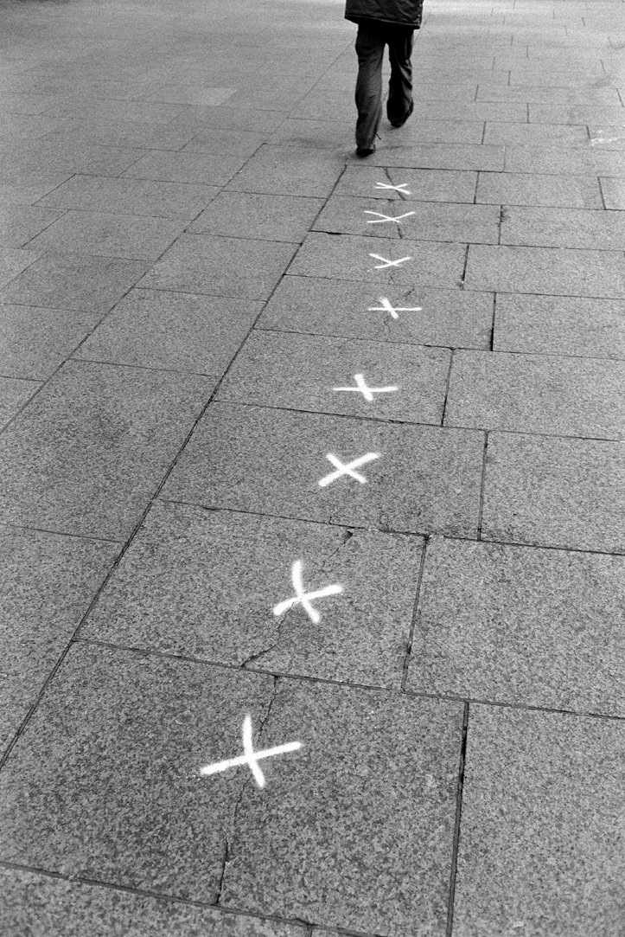
It’s all about trust(s)
Ticking all the boxes
Following the recent death of Bob’s wife, Bob arranges a meeting with his adviser to review his finances
Bob, now a widower, has two dependent children
He has a single life insurance policy for £250,000
This policy is not in trust
What are the benefits to Bob for writing his existing policy into trust?

Slide 31
It’s all about trust(s)
Ticking all the boxes
Bob’s estate
Royal London
Life Cover £250,000
Let’s look at the value you can add by writing Bob’s Royal London plan into trust
Taxable estate £500,000
Net estate value £750,000
Nil rate band £650,000
Liable for IHT £100,000
Tax bill £40,000
Probate fee £22,500
(If 3% fee charged for probate work)

Slide 32
It’s all about trust(s)
Ticking all the boxes
adviser.royallondon.com/protection

Slide 33
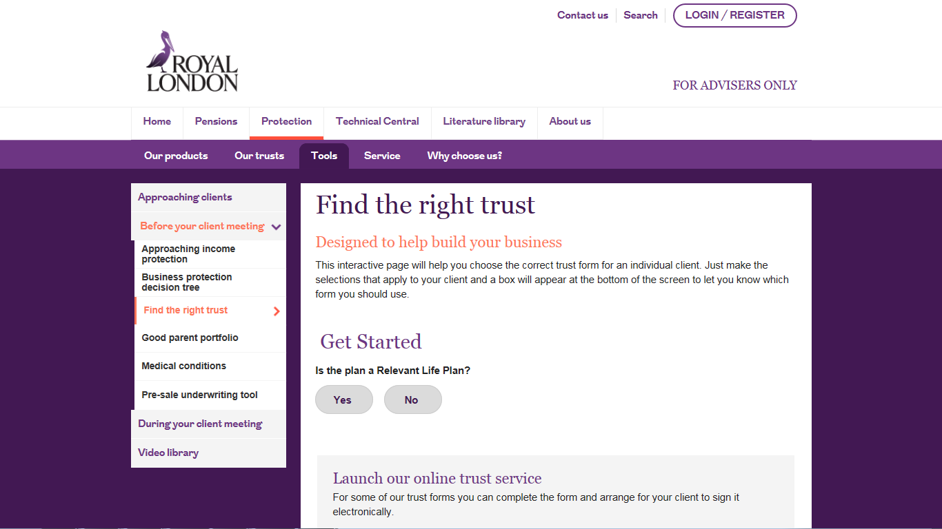

Slide 34
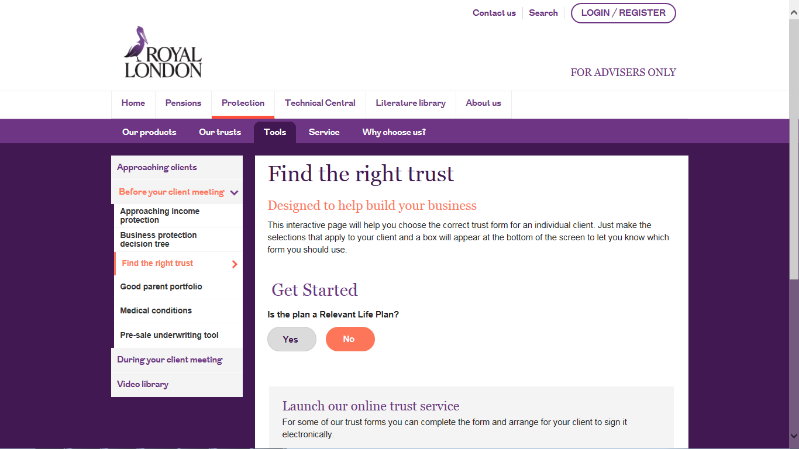

Slide 35
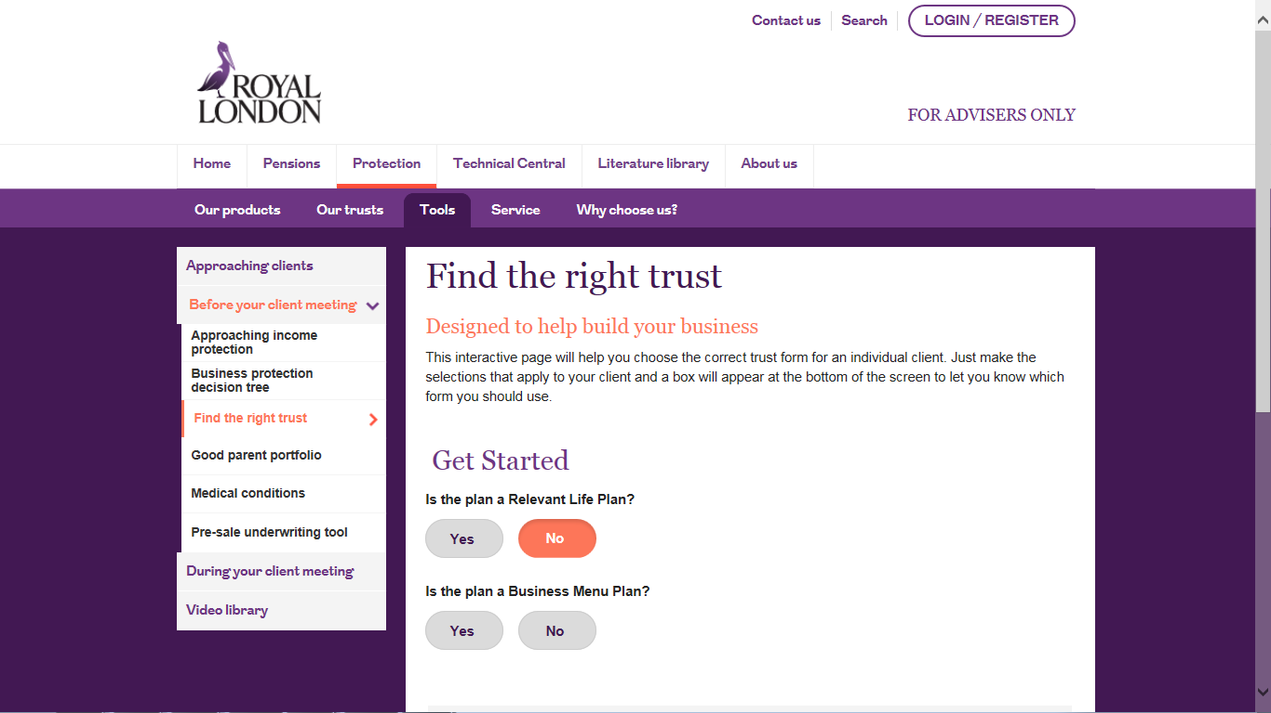

Slide 36
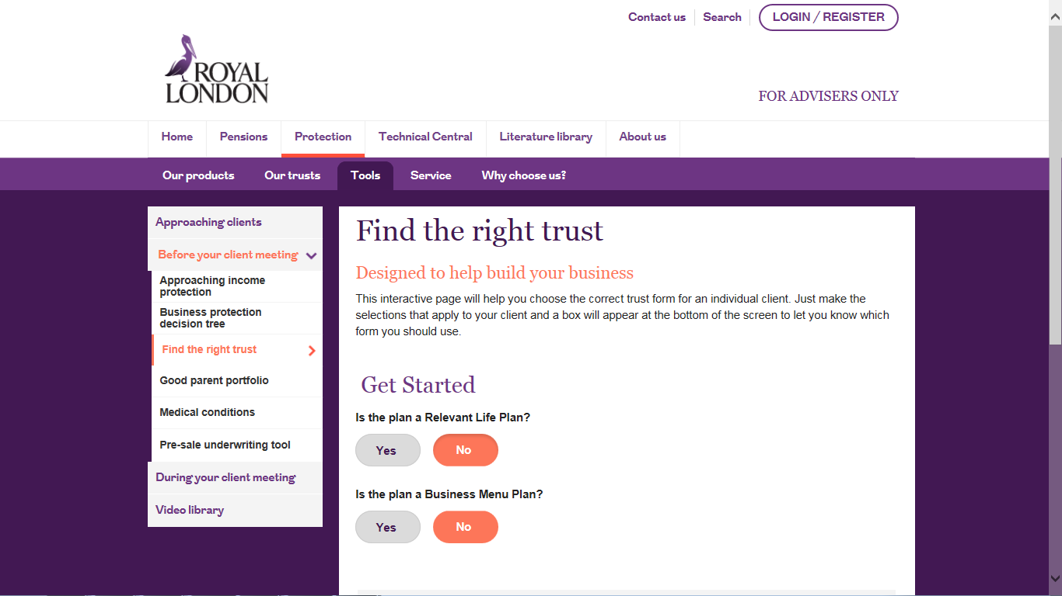

Slide 37
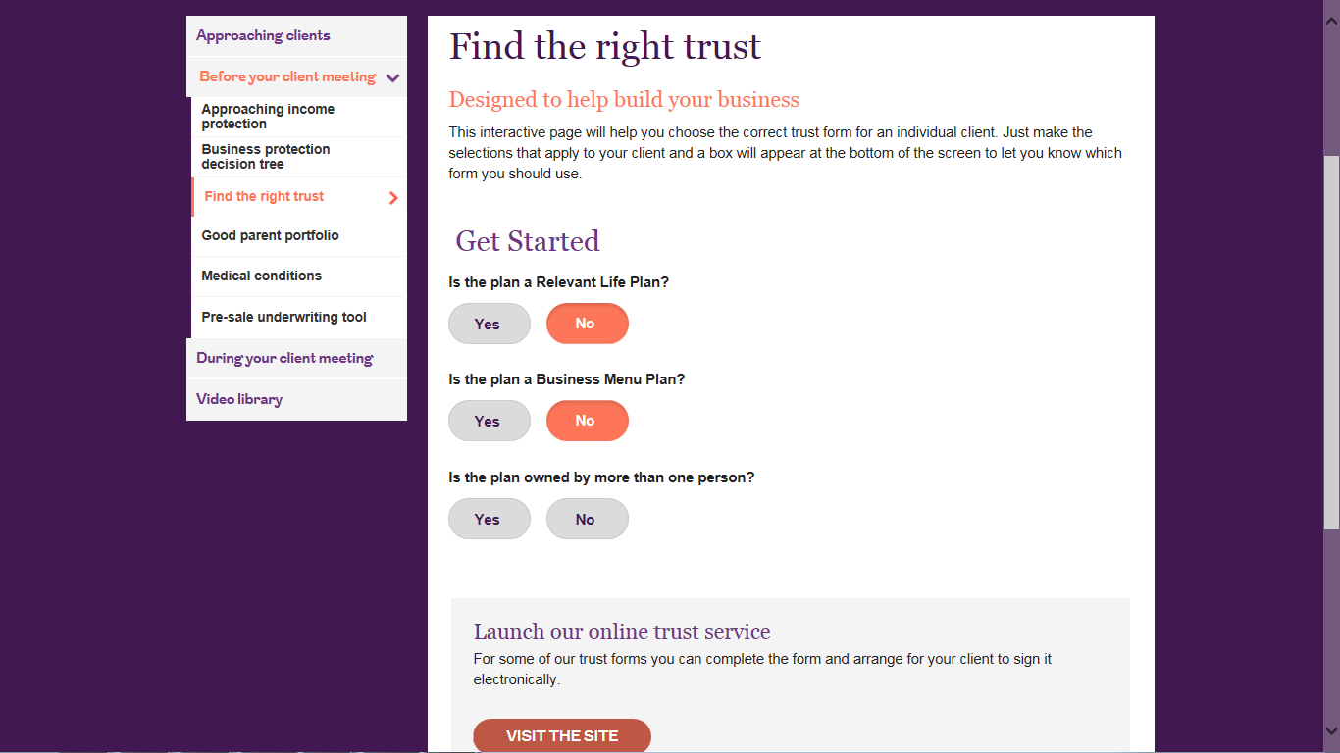

Slide 38
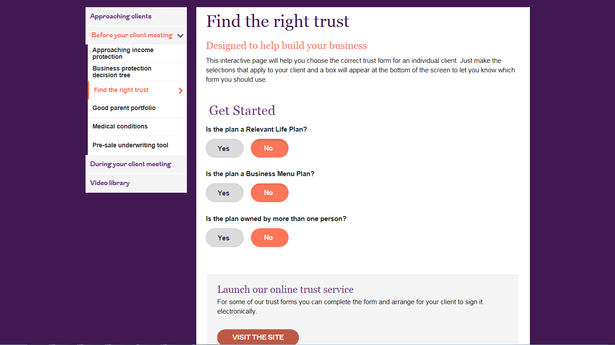

Slide 39
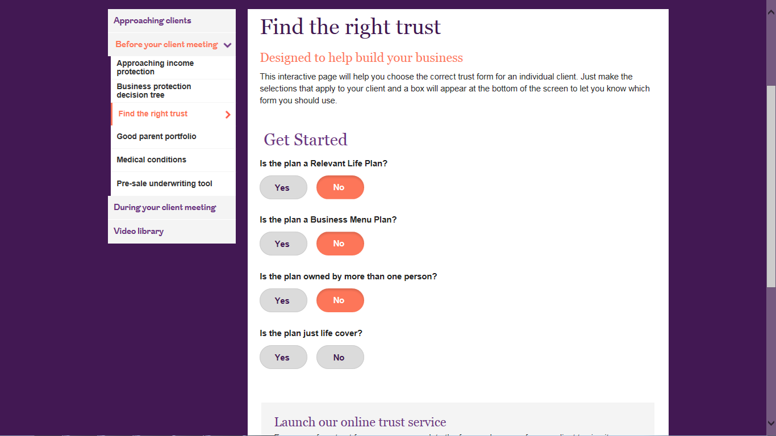

Slide 40
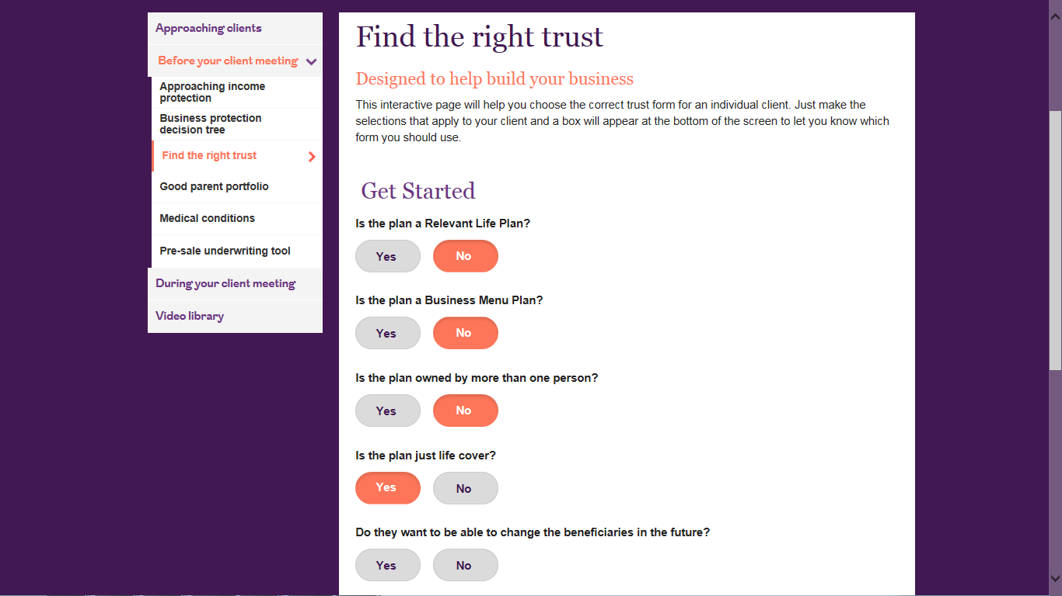

Slide 41
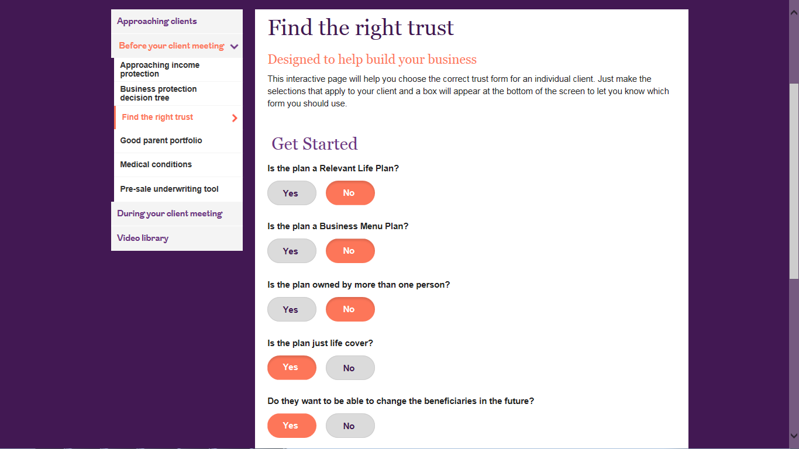

Slide 42
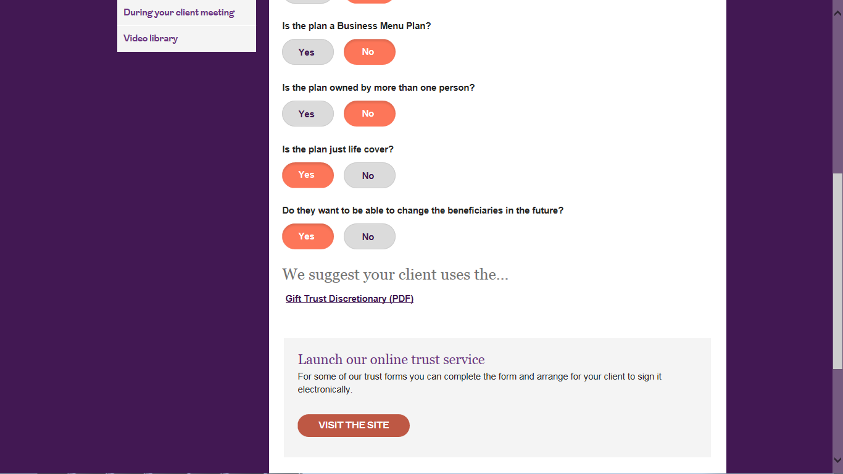

Slide 43
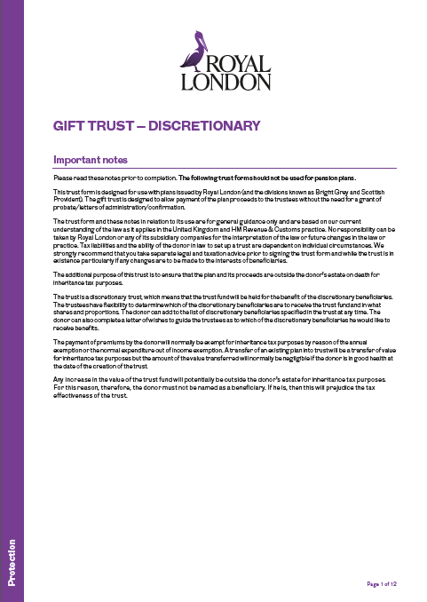
It’s all about trust(s)
Royal London Gift Trust - Discretionary

Slide 45
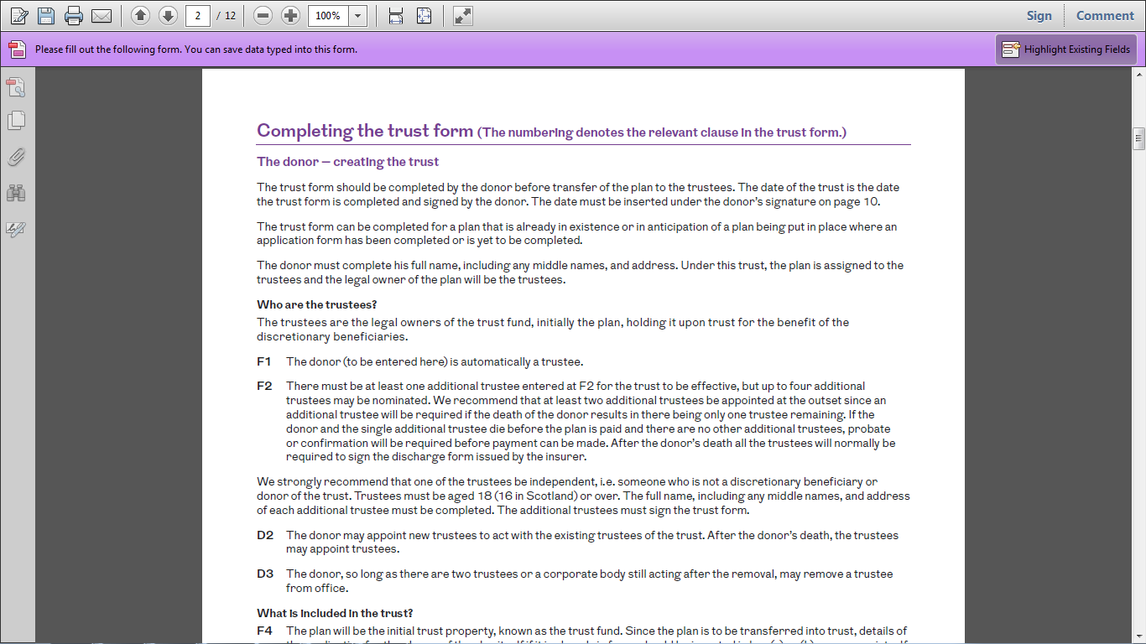

Slide 46
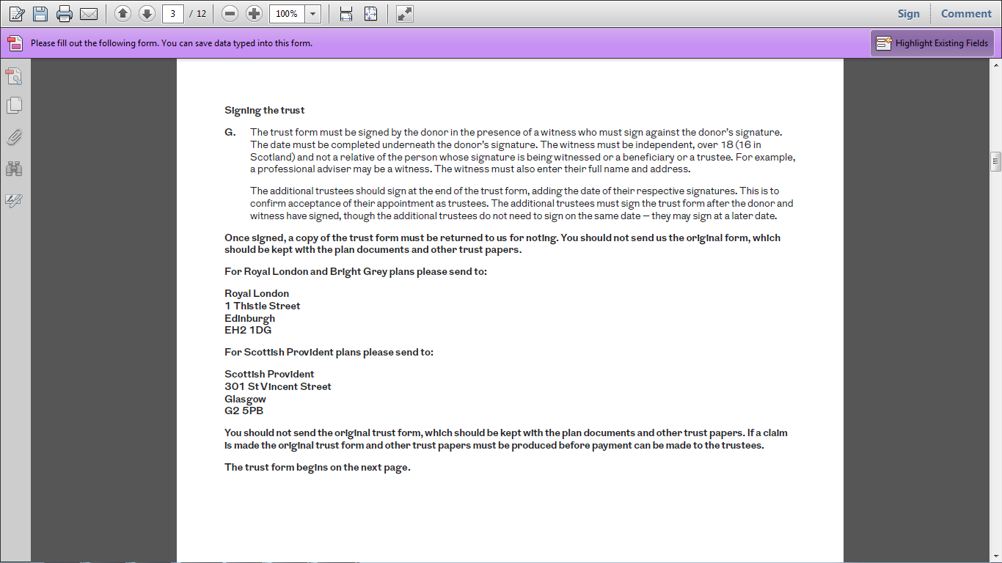

Slide 47
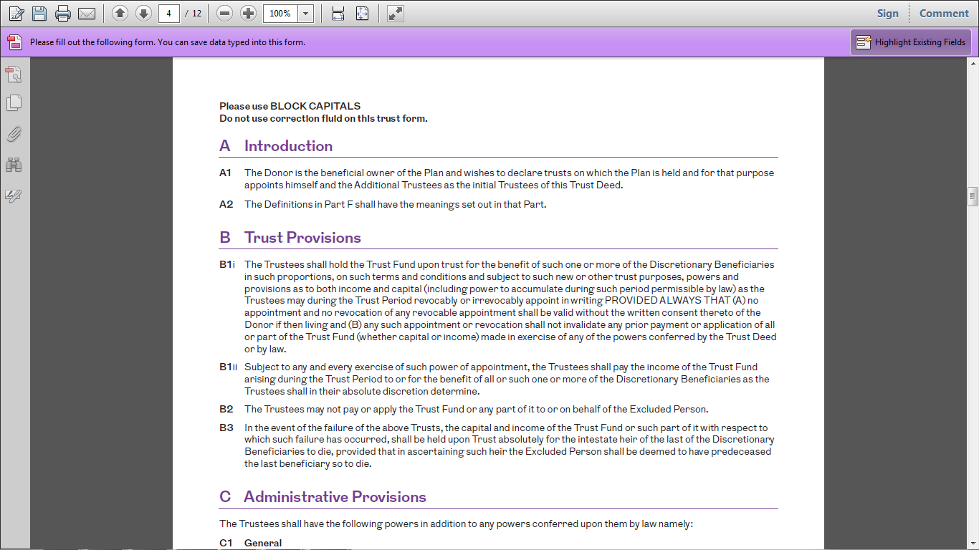

Slide 48
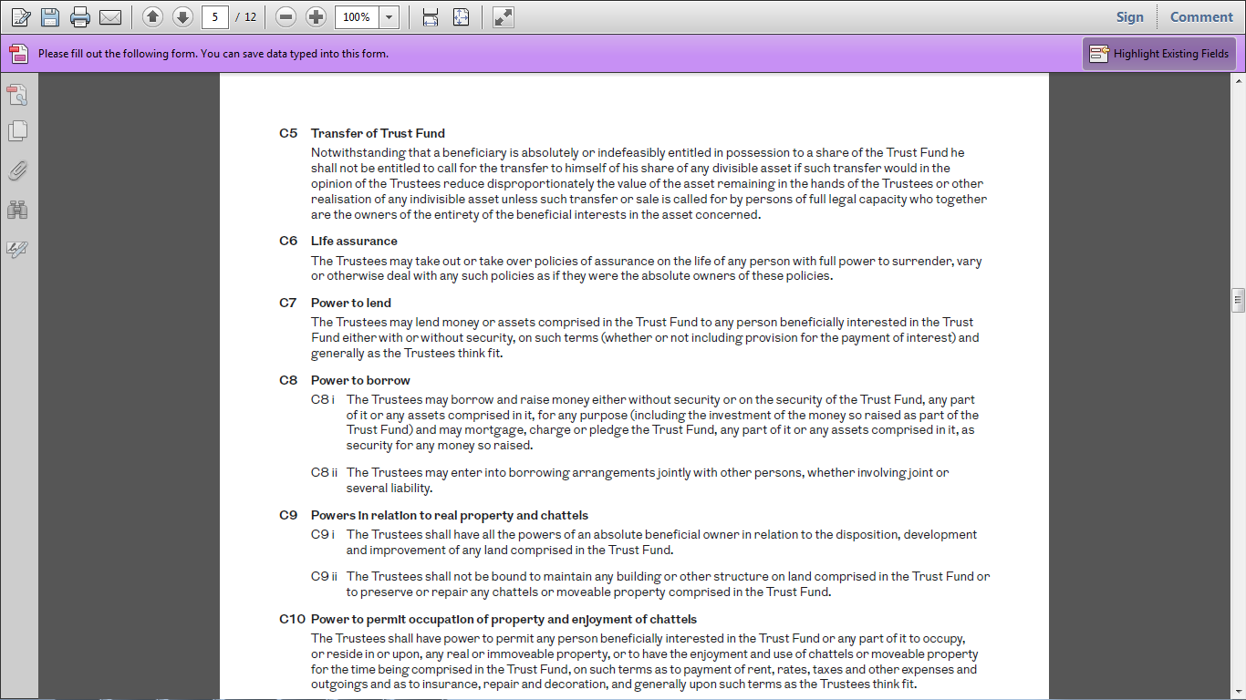

Slide 49
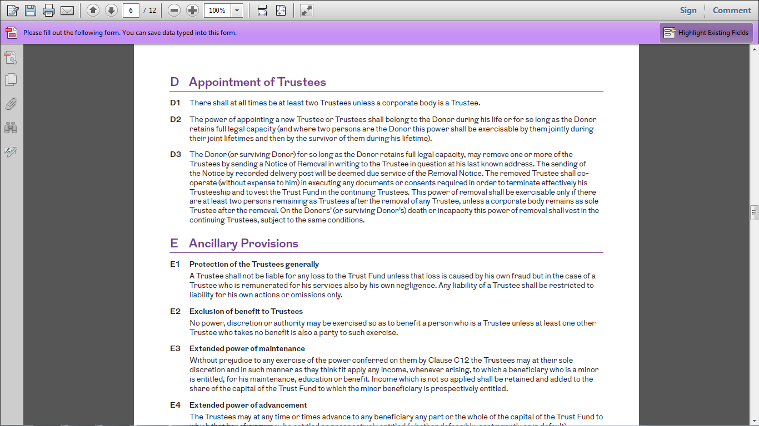

Slide 50
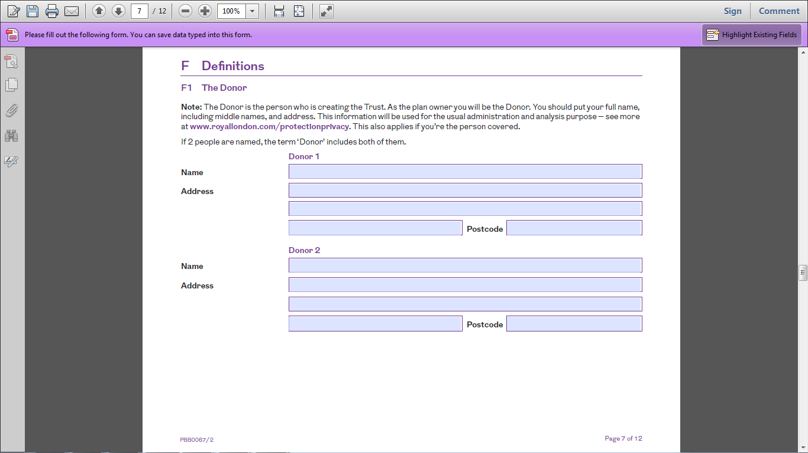
ROBERT EDWARD SMITH
15 HIGH STREET, BIRMINGHAM
B1 2AA

Slide 51
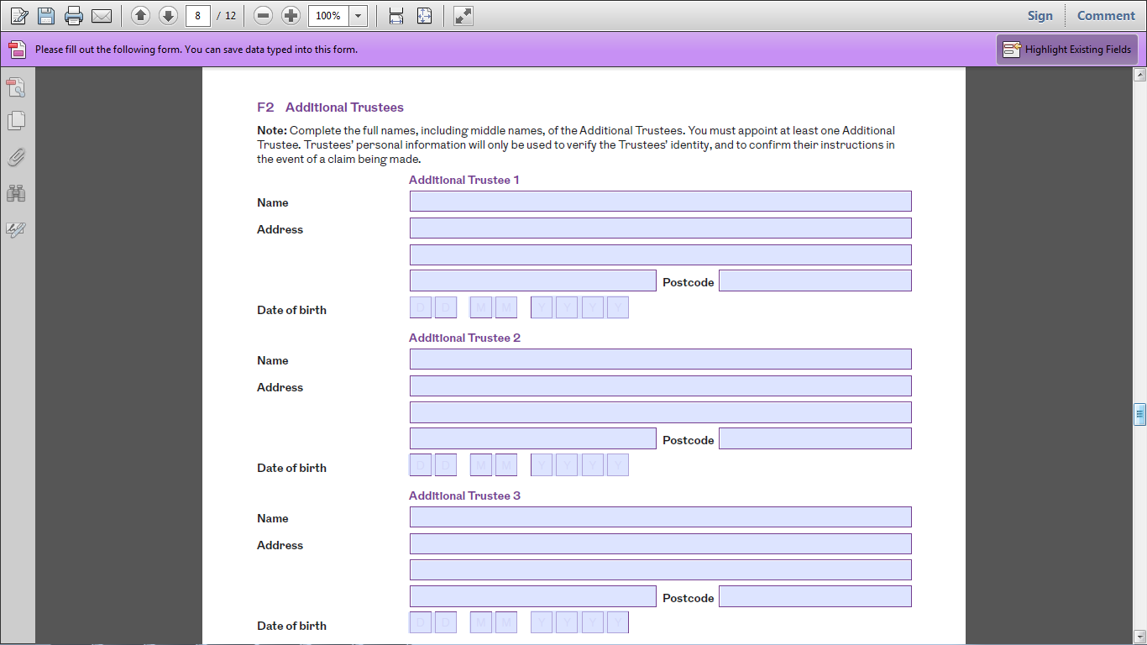
JAMES MARK SMITH
1 SPRING LANE, WEST BROMWICH
B71 1BB
0 1 0 1 1 9 7 9
JENNIFER EDWARDS
1 STATION ROAD, COVENTRY
CV1 2CC
0 1 0 2 1 9 8 0
BRIAN JONES
5 MAIN STREET, DUDLEY, BIRMINGHAM
B64 3DD
0 1 0 3 1 9 8 1

Slide 52
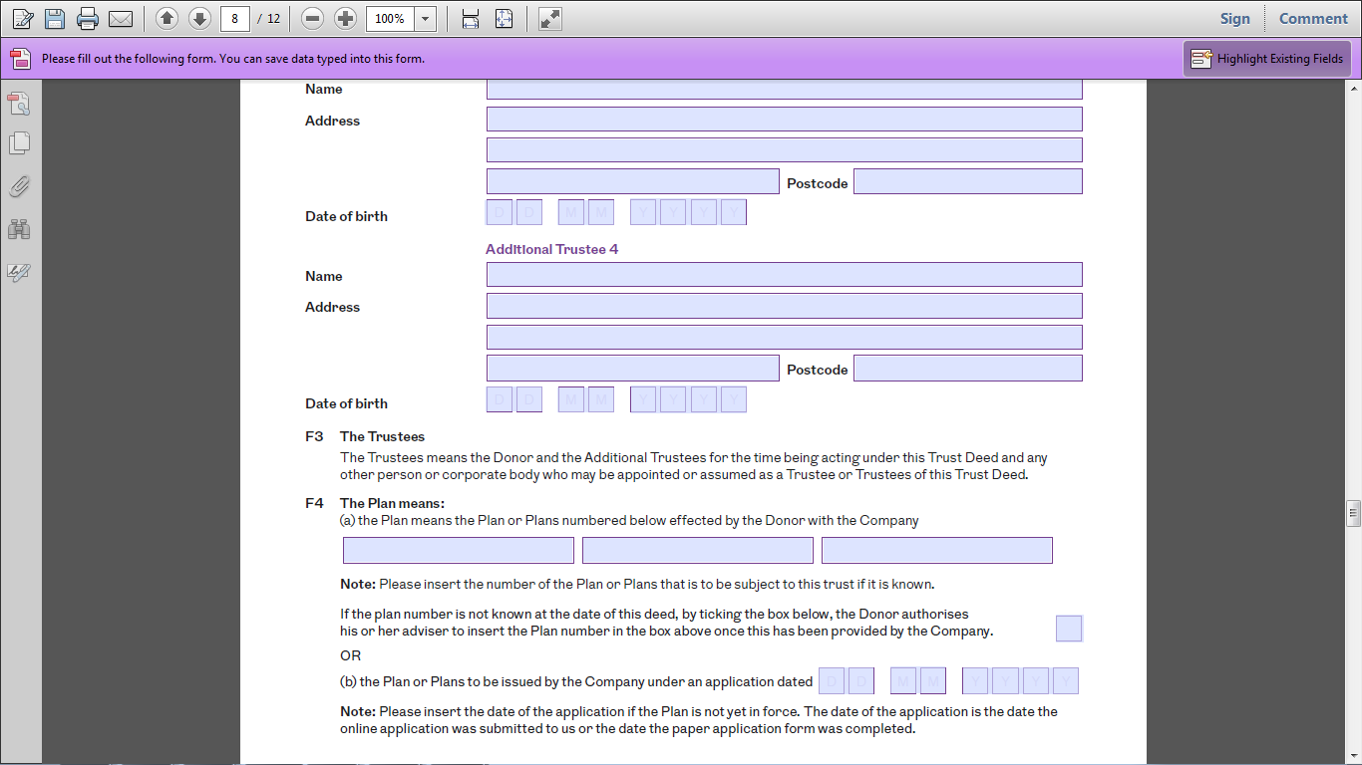
BRIAN JONES
5 MAIN STREET, DUDLEY, BIRMINGHAM
B64 3DD
0 1 0 3 1 9 8 1
11223344

Slide 53
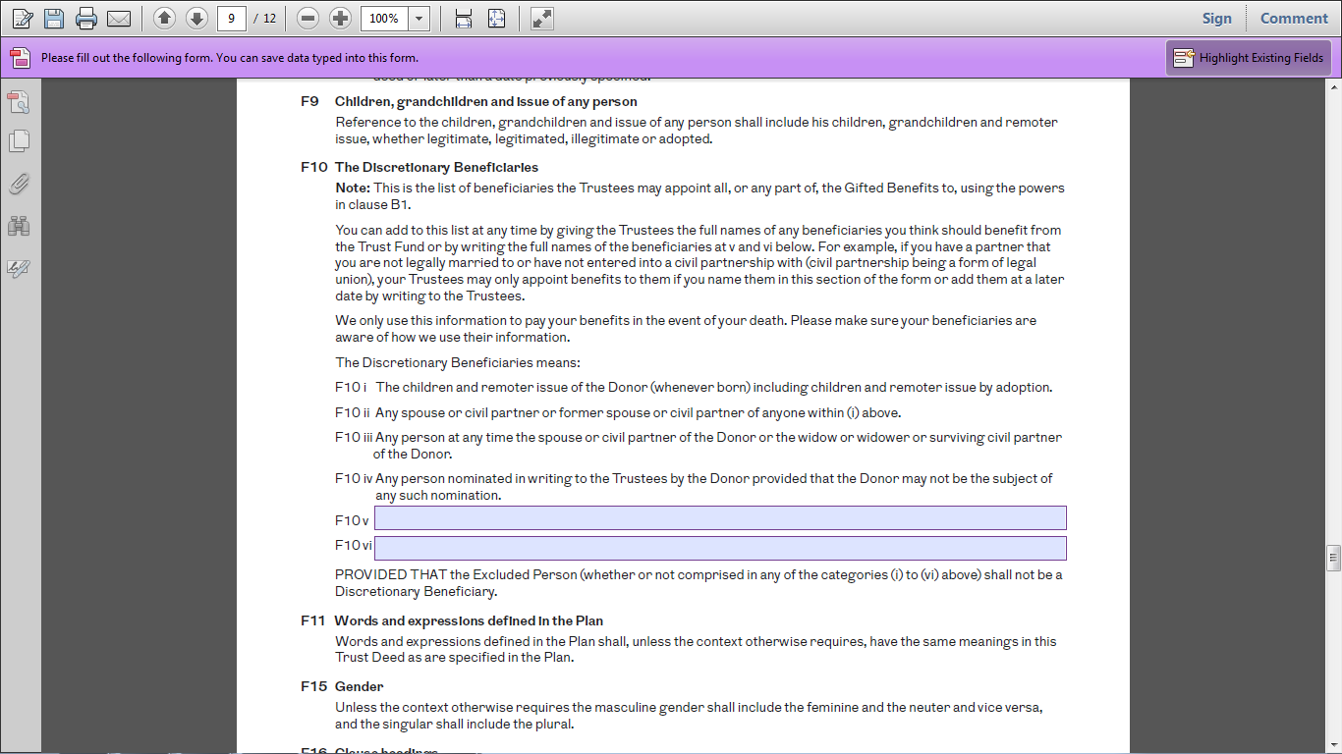

Slide 54
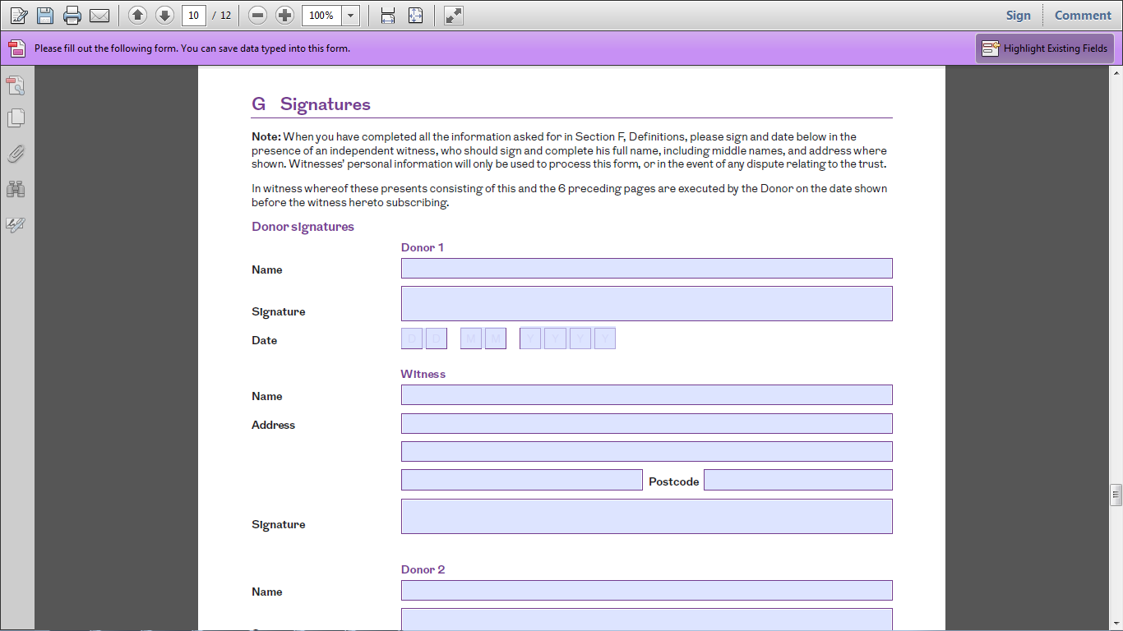
ROBERT EDWARD SMITH
Robert E Smith
0 1 0 5 2 0 2 0
ANDREW ADVISER
1 PARK ROAD, BIRMINGHAM
B1 1BB
Andrew Adviser

Slide 55
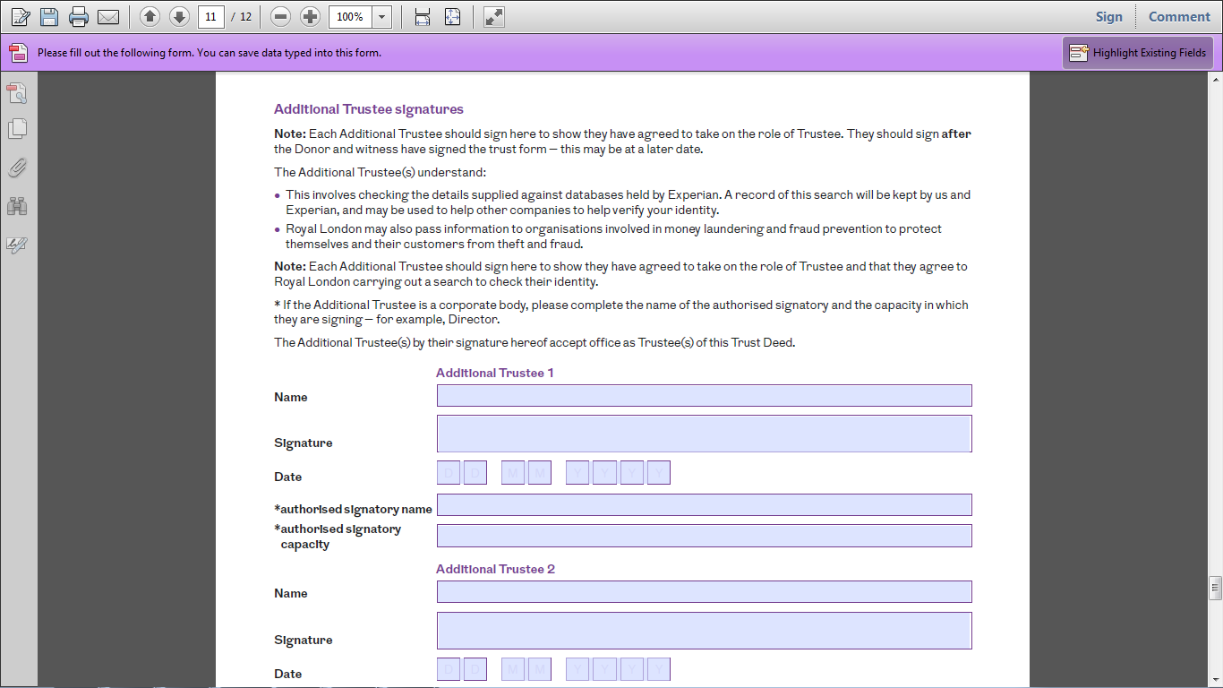
JAMES MARK SMITH
James Smith
0 2 0 5 2 0 2 0
JENNIFER EDWARDS
Jennifer Edwards
0 3 0 5 2 0 2 0

Slide 56
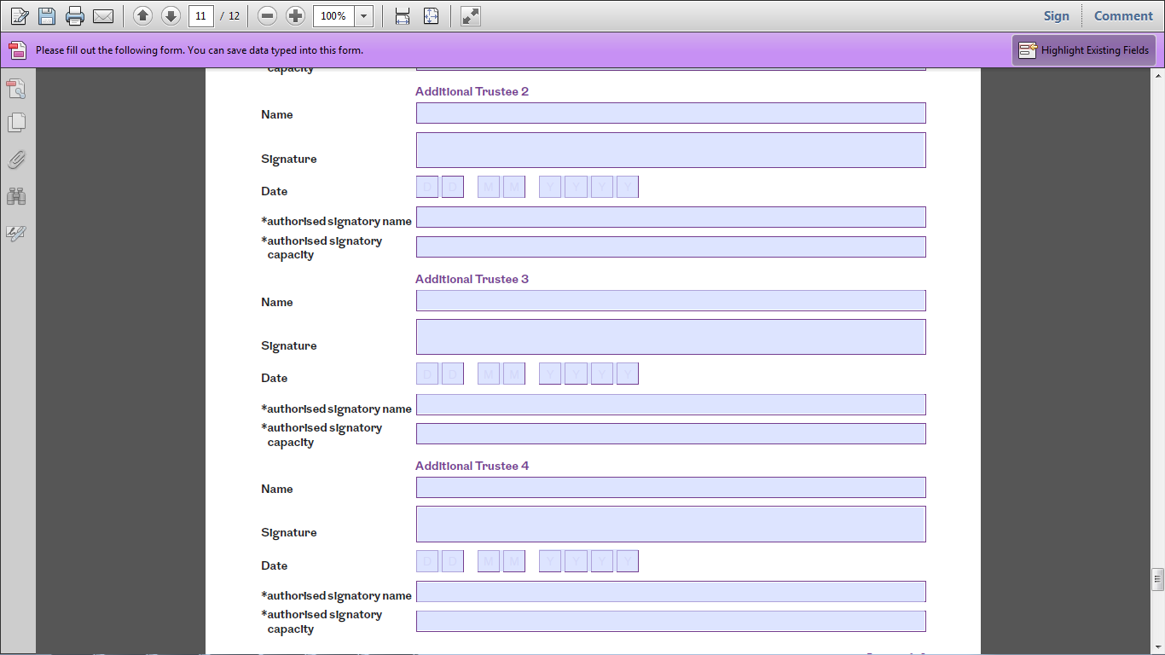
JENNIFER EDWARDS
Jennifer Edwards
0 3 0 5 2 0 2 0
BRIAN JONES
Brian Jones
0 4 0 5 2 0 2 0

Slide 57
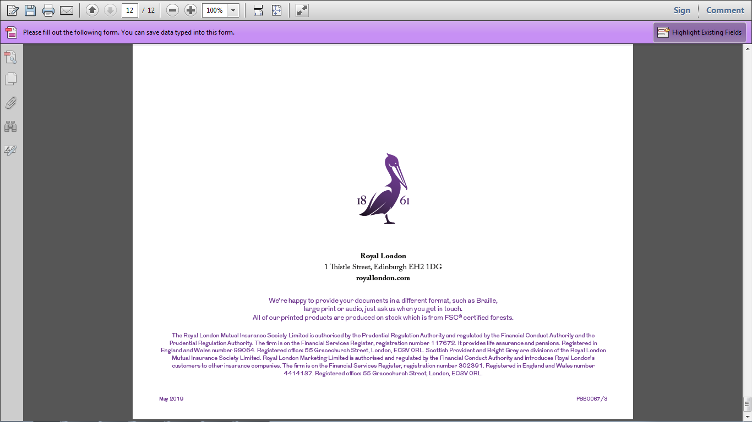

Slide 58
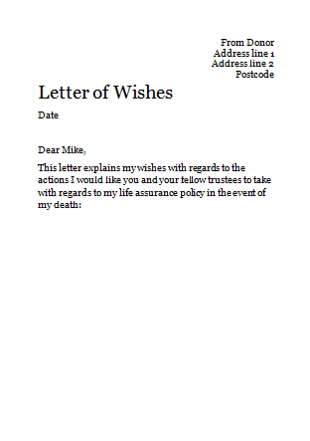
It’s all about trust(s)
Ticking all the boxes
Bob’s estate
Royal London Discretionary Gift Trust
Royal London
Life Cover
£250,000
Taxable estate £500,000
Net estate value £750,000
£500,000
Nil rate band £650,000
Liable for IHT £100,000
£0
Tax bill
£0
£47,500 saving
in this example!
Probate fee £22,500
£15,000
(If 3% fee charged for probate work)

Slide 59
It’s all about trust(s)
Adding true value
✗
✓
Bob before advice
Bob after advice
Inheritance tax bill of £40k
Potential probate fees of £22.5k
No guardianship provision
Delays in releasing funds from life policy due to probate
No provisions for who should receive the funds from the policy
No inheritance tax to pay
Reduced probate fees
Guardianship provisions set up
No delays in releasing funds from life policy
Clear instructions for trustees for distribution of funds from the policy

Slide 60
Letter
Of wishes

Slide 61
It’s all about trust(s)
Letter of wishes
Key considerations:
Is it clear from the trust form exactly how the donor would wish to distribute the policy proceeds?
What if a beneficiary dies?
What if you need to change a beneficiary?
Any particular circumstances for distribution of proceeds?

Slide 62
It’s all about trust(s)
Each trustee gets a copy
Letter of wishes - example
The trustees of the Brian Jones - gift trust discretionary trust of 1st May 2020
Dear
Name of trustee
This letter explains my wishes with regards to the actions I would like you and your fellow trustees to take with regards to my life insurance policy in the event of my death:
My first priority is that my wife Jane is adequately provided for. Therefore it is my wish that while my spouse is alive you should look to make full payment to her from my life policy.

Slide 63
It’s all about trust(s)
Letter of wishes - example
Subject to point 1, I would then want the trust fund to be used to support the upbringing of my children. As such I would ask you to make regular payments to the guardians of my children to support their upbringing whilst they are still of a dependent age.
Subject to points 1 and 2, once each of my children reach age 18, I would ask you to make equal payments to each child from the remaining trust fund.
Brian Jones
Brian Jones
Date – 1st May 2020
You should review the content of this letter of wishes with your client at your review meetings.

Slide 64
The Royal London
Solution

Slide 65
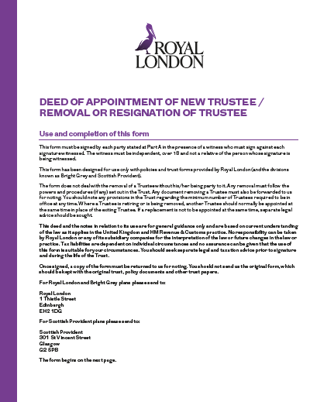
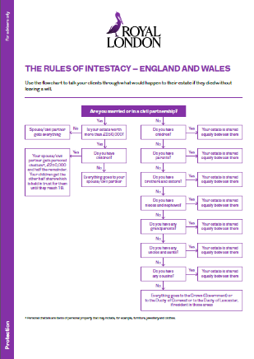
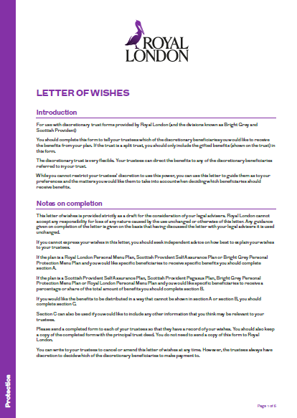
It’s all about trust(s)
The Royal London solution
Deed of appointment
of a new trustee
Intestacy
flow charts
Letter of wishes
template
Trust forms
(or the removal
of a trustee)
(England & Wales,
Northern Ireland,
Scotland)

Slide 66
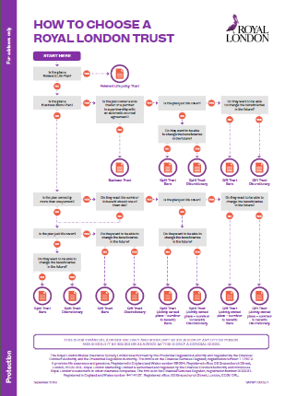
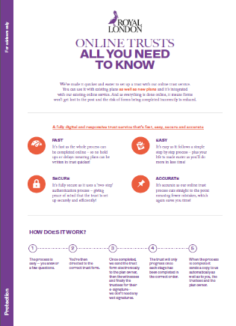
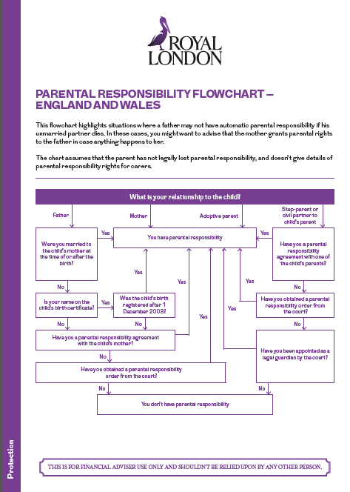
It’s all about trust(s)
The Royal London solution
Parental
responsibility
flowcharts
How to choose a
Royal London trust
Online trusts
explained
(England & Wales,
Northern Ireland,
Scotland)

Slide 67
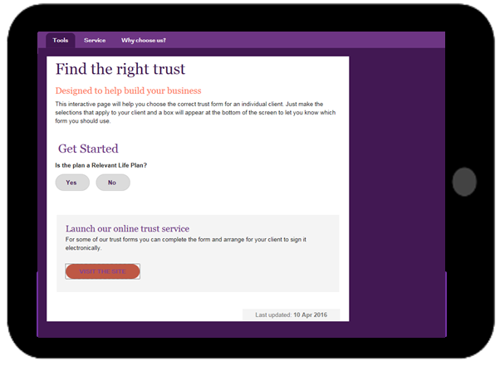
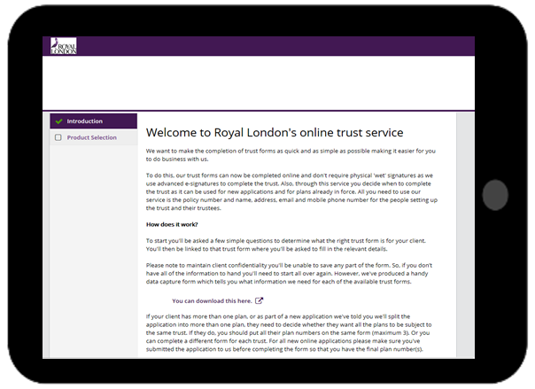
It’s all about trust(s)
The Royal London solution
All our forms and guides are online and available to download and send to your clients - adviser.royallondon.com/literature
The range of online tools in our trust toolkit mean you can still help your clients even if you’re now working remotely.
Find the right trust tool
Online trusts
Notes:
Online trust tools available from adviser.royallondon.com/protection/tools – trust toolkit is under the ‘During your client meeting’ section.

Slide 68
It’s all about trust(s)
Adding real value - call to action
Identify your existing clients whose policies are not in trust – offer them a trust review.
Build your confidence by looking at your own policies – are they in trust? Letter of wishes?
Get a template for the letter of wishes.
Get a template to contact existing clients who have policies not written into trust
Write a basic agenda for trustee meetings.
What’s your ‘hook’ to invite trustees for a review.
We can help you – give us a shout!
Notes:
Read slide

Slide 69
It’s all about trust(s)
Learning outcomes
Understand the business opportunities of making trusts a key part of your protection proposition
Have a wider understanding of what happens in the probate process and why this takes months to complete
Accurately be able to locate and complete a Royal London trust form for a protection policy
Describe the importance of the letter of wishes and why this should be reviewed periodically
adviser.royallondon.com/protection

Slide 70
Questions about
trusts

Slide 71
Thankyou
The Royal London Mutual Insurance Society Limited is authorised by the Prudential Regulation Authority and regulated by the Financial Conduct Authority and the Prudential Regulation Authority. The firm is on the Financial Services Register, registration number 117672. It provides life assurance and pensions. Registered in England and Wales number 99064. Registered office: 55 Gracechurch Street, London EC3V 0RL. Royal London Marketing Limited is authorised and regulated by the Financial Conduct Authority and introduces Royal London’s customers to other insurance companies. The firm is on the Financial Services Register, registration number 302391. Registered in England and Wales number 4414137. Registered office: 55 Gracechurch Street, London EC3V 0RL.
April 2020
PR P8 PN 0193

Slide 72
5 Minutes Max!

Slide 73
Useful Letter
Dear X
I trust you and your family are keeping safe and well during this unusual and unprecedented situation we find ourselves in.
It appears from my records that you hold insurance policies such as life assurance, but I have no record about these being written into ‘Trust’?
‘Trusts’ are a legal framework which allow you to nominate appropriate beneficiaries, but also ensure that if a claim ever needs to be made; there will not be any lengthy delays by way of probate.
Using an appropriate ‘Trust’ also ensures that any claim proceeds will not be subject to Inheritance Tax (which is currently 40%).
Using Trusts is a really important consideration and therefore, I would therefore like to invite you for a ‘Trust review’ meeting at mutually appropriate time.
We can do this meeting over the web and I will be able to explain this in more detail and arrange the paperwork for you. We will spend no longer than 45 minutes.
Please call me on XXXXXX or email on XXXXX and I will look to arrange a meeting with you.
Many thanks

Slide 74
The Trust Process
Richard Coulson
3 Rs
Choosing a Trustee (3)
Trustee Nomination Form
Explain Send 3 Rs and Trustee Guide (any provider)
Reinforce client understanding
Client Phones Trustees to expect your call
Send 3 Rs and the Trustee Guide (any provider)
Call Trustees to book appointment (Zoom/screen share)
35 minutes max
The Trustee call – show 9 boxes
Objectives – a) gain agreement to be trustee
b) gain agreement for trust audit / factfind
Confirm to client Trustees x 3 agreements
Confirm Trustees 1, 2 and 3 to each other
Repeat the process on Trustee/new client

Slide 75
By putting your personal protection policies in trust, you can make sure the right money makes it into the right hands at the right time.
If we told you about a product that:
was free
could save you 40p in every £1
could save you months of legal wrangling
Would you be interested?
That product is a trust. Putting your policy in a trust:
is free
may save inheritance tax
avoids probate delay
Give yourself complete peace of mind. Call and speak to us today about the essential benefits of putting your personal protection policies in a trust.
TRUSTS
Made Simple
£
202 Oakbrook Road
Sheffield, S11 7ED
Telephone: 0114 229 1900
Web: www.optimumfs.co.uk
Is your life insurance policy written in trust?

Slide 76
Right money
You can use a trust to give some or all of the beneﬁts from your life or critical illness insurance policies to other people such as a spouse or children. This means that the beneﬁts you give away would not form part of your estate if you die and therefore would not be subject to Inheritance tax.
Right hands
Trusts are ﬂexible, which means you have control over who will beneﬁt from your cover and who will be responsible for making sure that happens.
Right time
If your policy is written in trust it allows your insurance provider to pay any claim you make more quickly than they could if the policy wasn’t written in trust. If a policy isn’t written under trust your personal representatives may have to obtain a Grant of Representation before they can deal with your policy. That process could take several months.
right hands
right money
right time
£
£
£
Inheritance tax is currently payable at 40% on any part of an estate valued over £325,000 (2019/2020). If you don’t put your personal protection policies in trust, any payment on claim is added to your estate for Inheritance tax calculation purposes.
When you’re setting up a trust, you have control over who will administer any money paid out from a claim (the trustees) and who will beneﬁt from any money paid out (the beneﬁciaries). You can also ensure that you personally receive any beneﬁts that you wish to retain for yourself. A good example of this would be a payment following a critical illness claim.
.
With the correct advice, putting your policy in trust is simple and can avoid this delay. There are several trust options and forms available so we are here to help ensure that you are able to decide which one best suits your own unique personal circumstances.
Back

Slide 77
Choosing a Trustee
Relationship TRUSTee
Age
Financial Situation / Awareness
Family
Health
Location
Mindset
Back

Slide 78
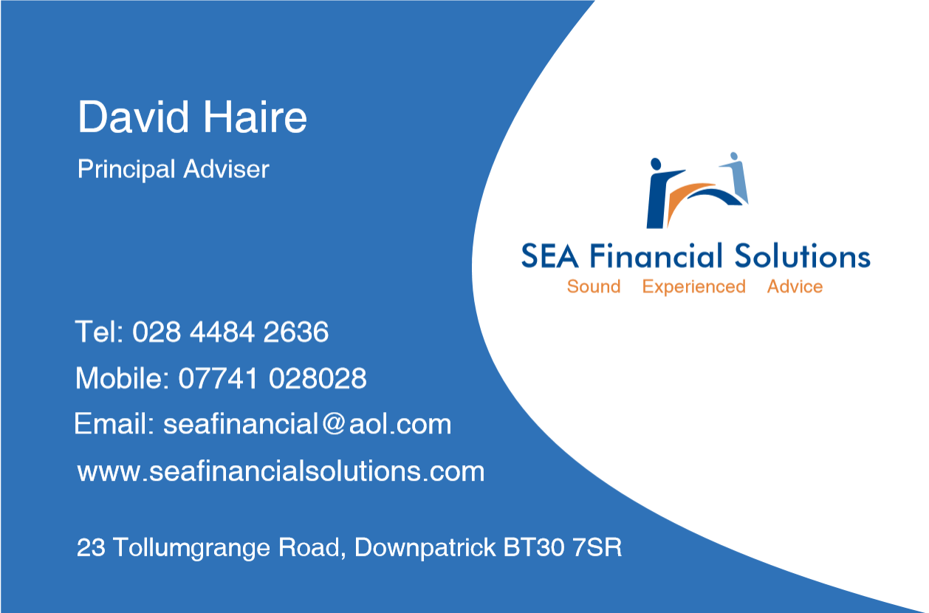

Slide 80
Assets
Life Insurance
House
Car
Personal Possessions
Future Inheritance
Liabilities
Mortgage/Rent
Utilities
Insurance
Rates
T.V.
Phone
£1,000 pm
ESTATE
Next of Kin
Tax Man 40%
IHT
£325,000
Grant of Probate
9-12 Months
Net Estate
Solicitor
2%-10%
Discretionary Trust
10-14 Days
(100%)

Slide 82
Trustee Guide
x3
Back

Slide 83
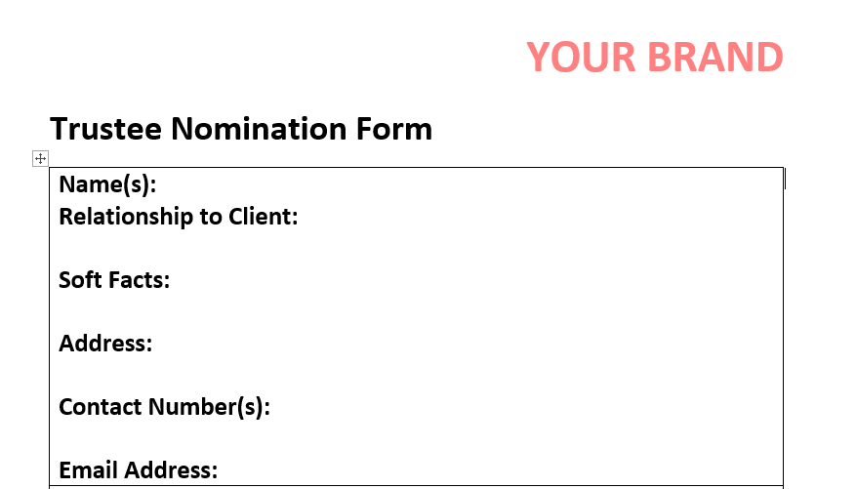
Trustee Nomination Form
x3
Back

Slide 84
Explain
Relationship TRUSTee
Age
Financial Situation / Awareness
Family
Health
Location
Mindset
Back

Slide 85
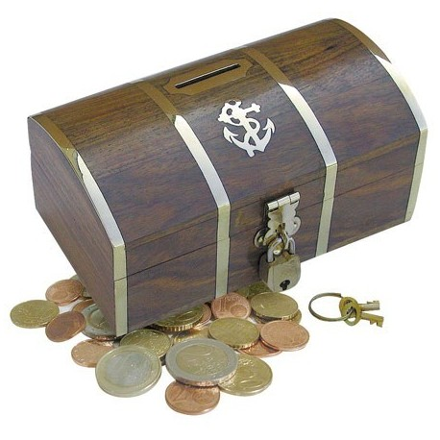
Reinforce Client Understanding
Richard
Annie
£360k 16yrs
£22,500pa 14yrs
£32.49pm
£18.26pm
3 Keyholders
Trustees
Letter of wishes
Back

Slide 86
Client calls Trustee
Trustee
Trustee
Bob & Jackie
Scott
Trustee
Rich and Annie
Coulson
Trustee
Dave and Sinead
Woodbridge
Trustee
Trustee
Free Trust Audit
Design Protection Portfolio
URGENT 14 days
Back
Notes:
Introduce the money maze and work through it.

Slide 87
Send 3Rs and Trustee Guide
Recorded Delivery on Saturday morning
Email Read/Receipt CONFIDENTIAL – PLEASE READ
Back

Slide 88
Call Trustees Script
Did Annie and Richard mention I would call?
I have sent you some information, did you get it? and can we put in an appointment.
I need to book some time with you this week as early as possible, and run through that info in detail and answer any questions you may have.
I have my diary handy, would you prefer a morning or afternoon appointment? Daytime or evening?
Wednesday or Thursday? 6.15pm or 8pm?
How long will it take? No longer than 35 minutes!
Back

Slide 89
Money Maze
INCOME GROSS | INCOME NET | LIABILITIES/DEBTS
DEATH | CANCER | SICKNESS / ACCIDENT
BUILDINGS AND CONTENTS | SAVINGS | STOP WORK
A
R
A
R
Trustees x3
Matthew
Harriet
Lillie
WILL x 3 referrals
Notes:
Introduce the money maze and work through it.

Slide 90
Trustee Call / Zoom
Build rapport
Annie & Rich Trustee journey
Reinforce Annie & Rich Protection Portfolio
2 x Treasure Chests Sums Assured & Premiums
3 Keyholders
3 Rs and Trustee Guide, any questions?
Are you already a trustee?
Is your portfolio in trust?
Free trust audit offer
REPEAT PROCESS
Back
Notes:
Introduce the money maze and work through it.

Slide 91
Confirm Trustees / Client
Email / Letters attached
Back
Notes:
Introduce the money maze and work through it.

Slide 92
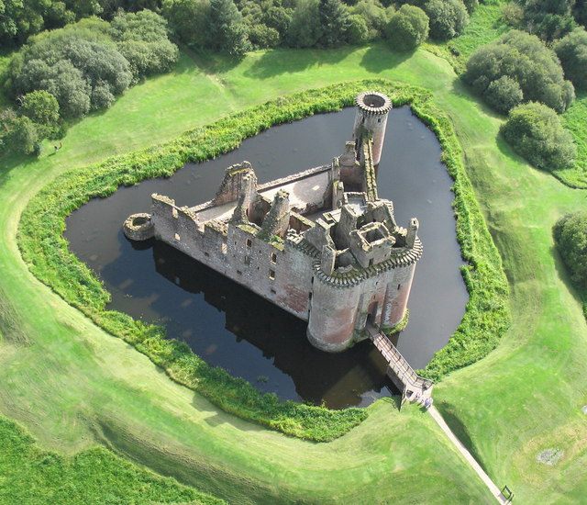
Ring Fencing Clients
Buildings & Contents - Barbed Wire Fence
Trust - Electric Fence
Will - Crocodile Infested Moat
Compulsory Annual Review - CCTV

Slide 94
Questions?

