Slide 1


  An Audience with…
Special guests +
Richard Coulson / Bob Scott

Slide 2

  Today’s Agenda
Darren Williams / Kieron Hogg – Platinum Financial Ltd
James Smyth – First Stop Mortgages and Protection NI

Slide 3
OSAD / 501
Daily
25pm
50pm
100pm
4001 200pm
5000pm!!!

Slide 4

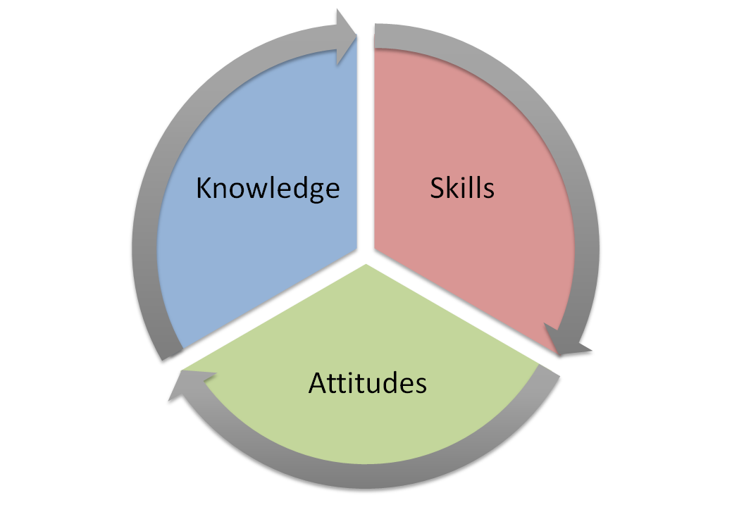
The ASK Model
Cancer, Heart Attack, Stroke
Sickness, Accident, Disability
Death
Trusts
Wills

Slide 5
Money Maze
INCOME GROSS | INCOME NET | LIABILITIES/DEBTS
DEATH | CANCER | SICKNESS / ACCIDENT
BUILDINGS AND CONTENTS | SAVINGS | STOP WORK
£3,100pm
£2,000pm
£5,100pm
Mort Halifax £150k - £500pm 25 yrs
Car
Loan - £275 – Nov 2020
CCs - £100
£50kpa
£30kpa
X4
x2
Trust –
3 referrals
£95.85pw
Deadline to Breadline – L and G
£6,000
64
62
Upgrade or rebalance your portfolio
Specialise in B and C
We will sort that for you
WILL x 3 referrals
Notes:
Introduce the money maze and work through it.

Slide 6
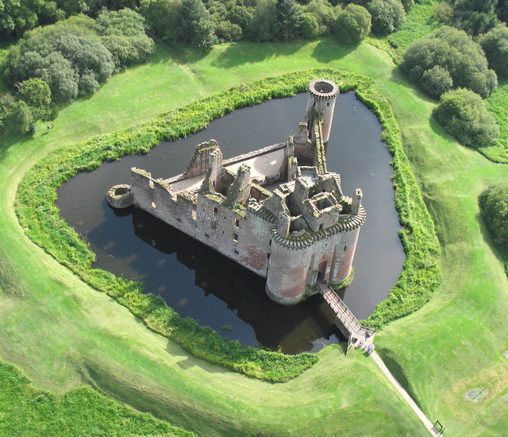
  Ring Fencing Clients
Buildings & Contents - Barbed Wire Fence
Trust - Electric Fence
Will - Crocodile Infested Moat
Compulsory Annual Review - CCTV

Slide 7
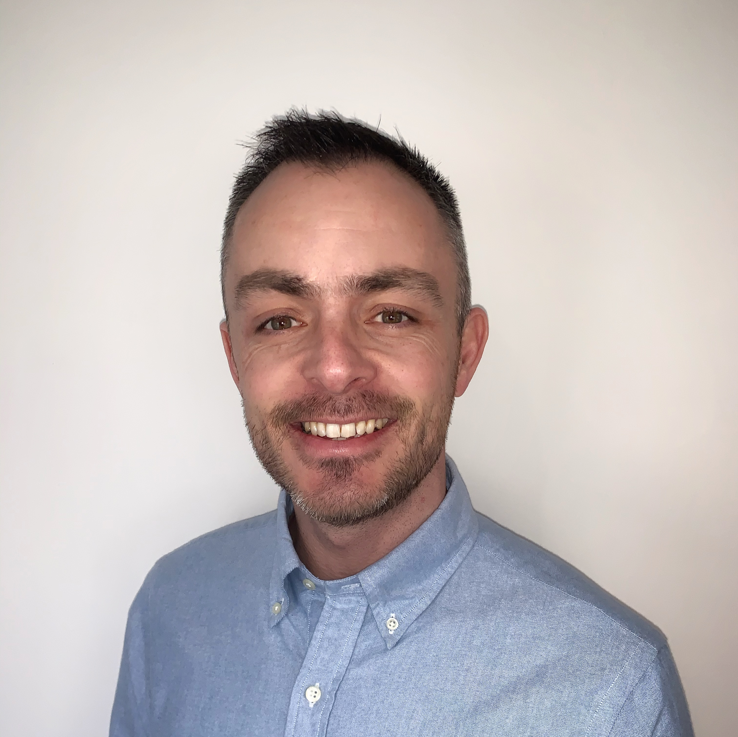
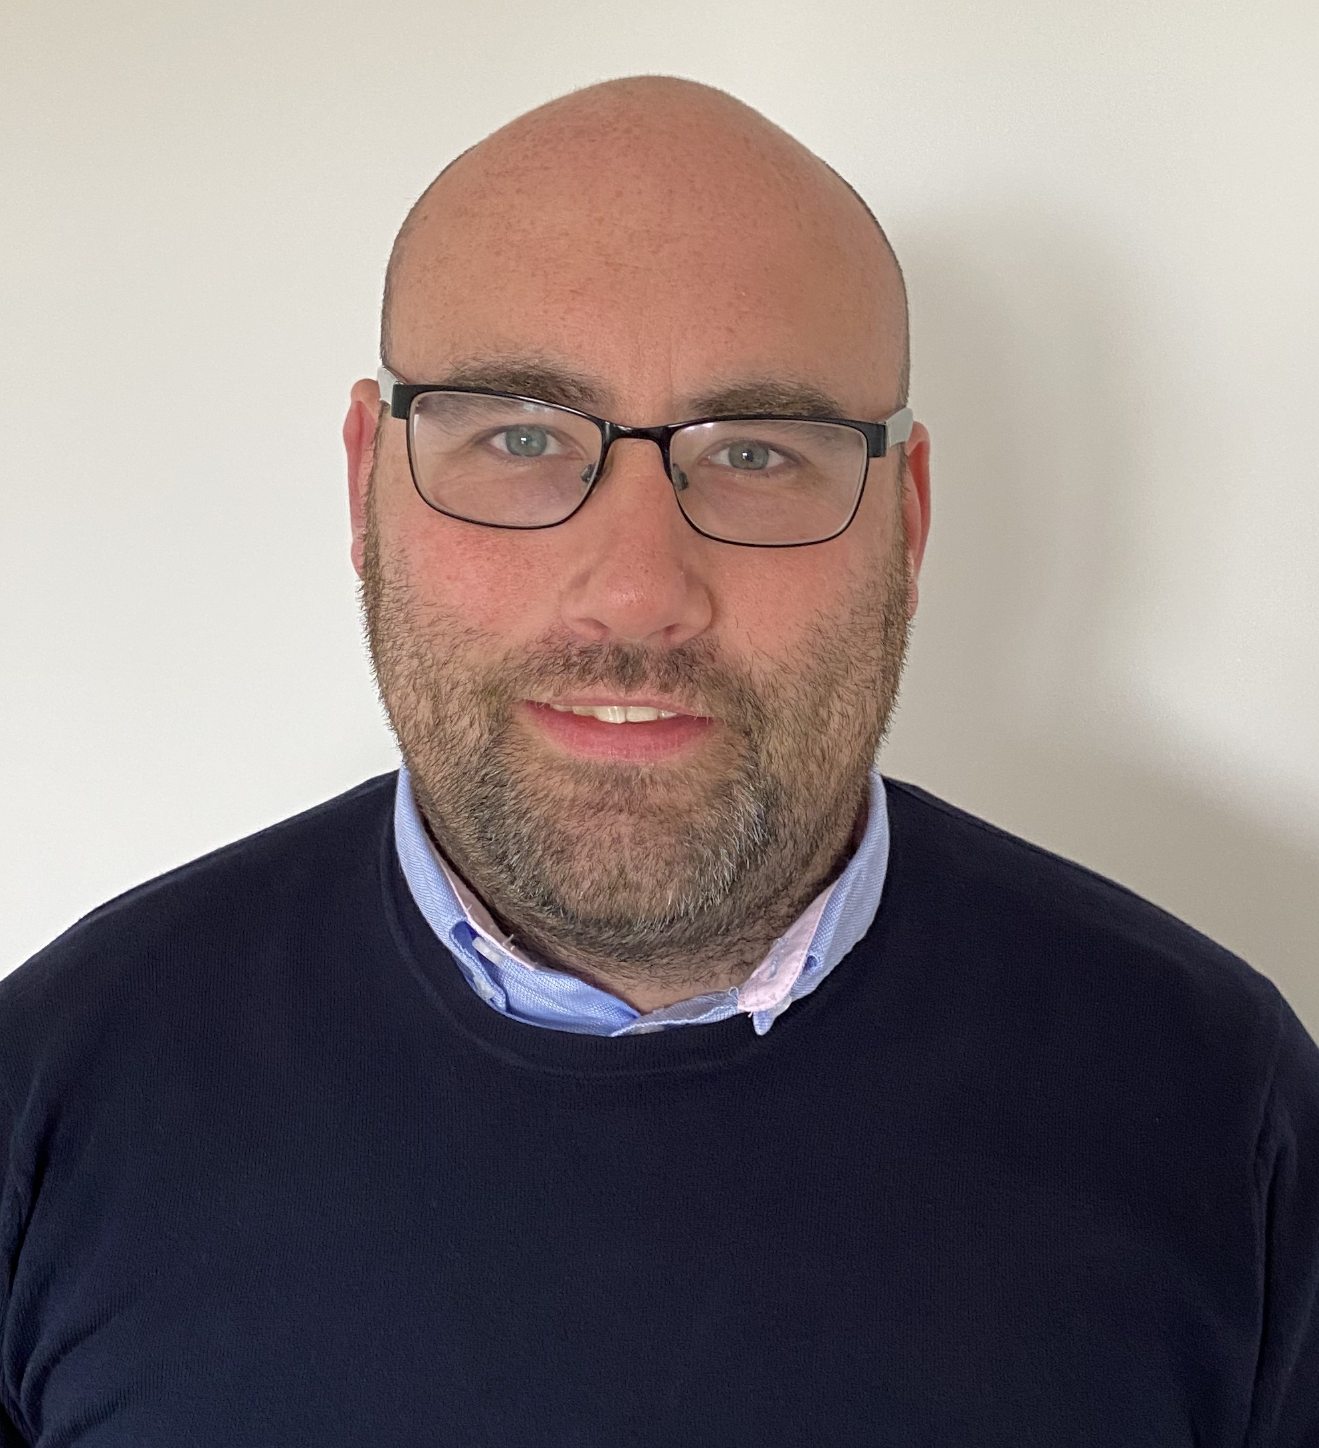

Darren Williams and Kieron Hogg
Platinum Financial Ltd

Slide 8
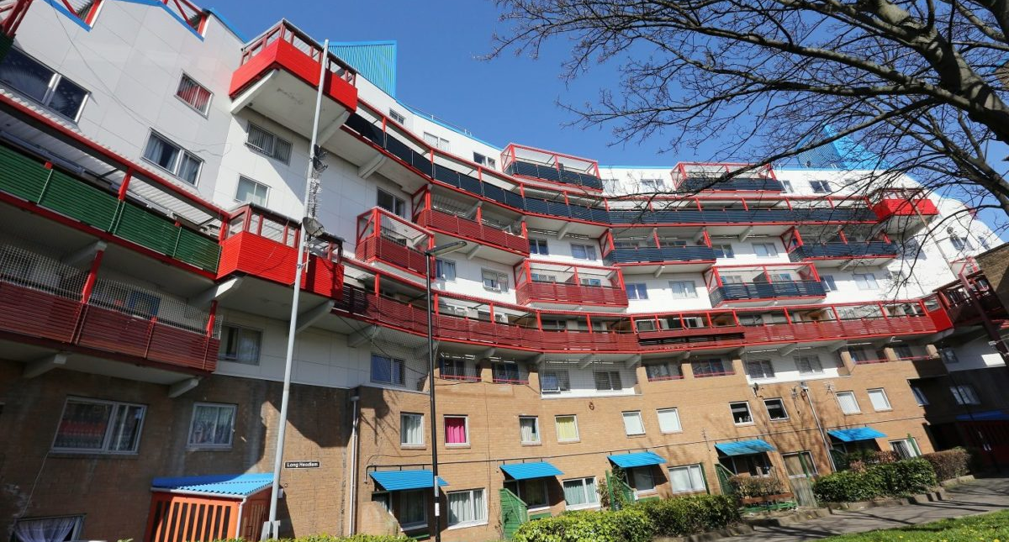

Slide 9
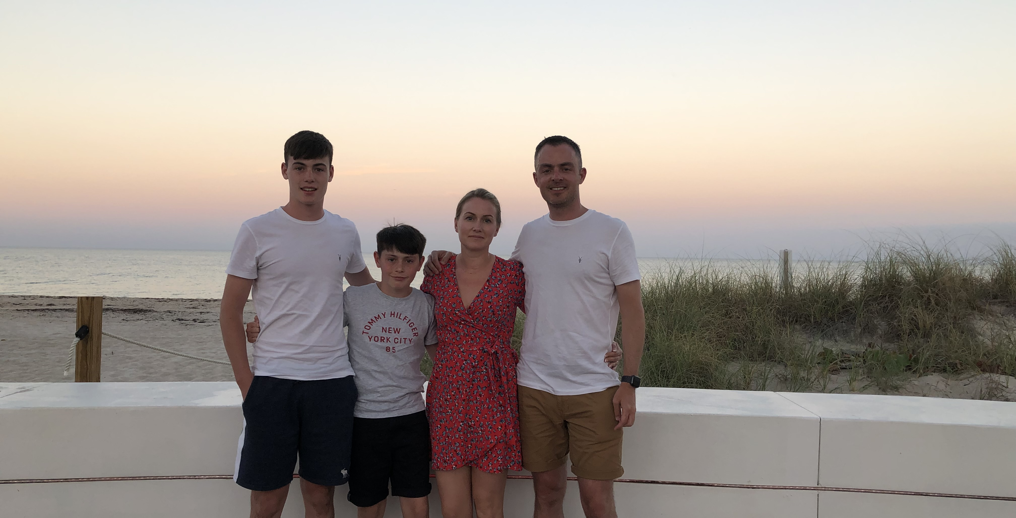
❤️ My Why ❤️

Slide 10
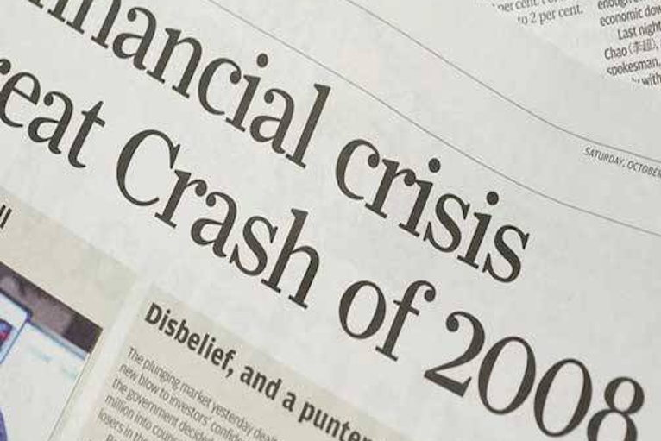
Oh
shit moment!

Slide 11
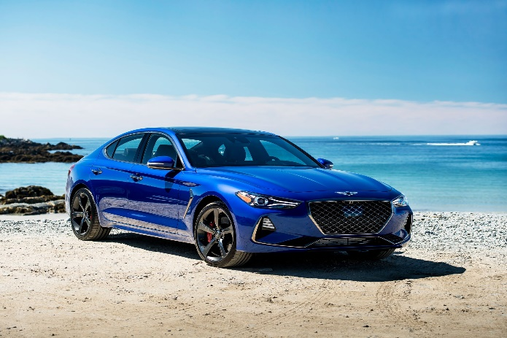

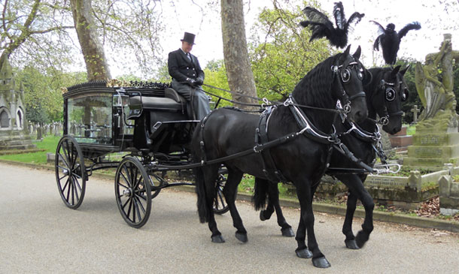

Slide 12

Order
Maker
to
Order
Taker

Slide 13
Take Will instruction
Establish protection need > Guardians or existing policies to begin financial review
Establish risk areas for Trust needs
North, East, South, West principle
Ask for referrals and social media reviews
Our Process

Slide 14
Appointment 1 - Compliance and Fact Find
Appointment 2 - Delivery of world class advice
Use referral sheet
Use trust sheet
Ask for reviews on social media
Trustees – client to set up my conversation
Fortune in the follow up
Celebrate the NO!
Our Process

Slide 15
Executor = Referral
Reserve Executor = Referral
Guardian = Referral
Reserve Guardian = Referral
North (Parents/Grandparents) = Referral
East (Brothers/Sisters) = Referral
South (Children/Grandchildren) = Referral
West (Close friends) = Referral
Trustees = Referral
Referrals = more referrals
The Return

Slide 17
OUR DNA
Maximise the opportunity by offering a world class service
Daily Method of Operation (goals, appointments, becoming a consultant not a GP!)
Work Life Balance
OUR PROCESS IS SIMPLE BUT GUARANTEES A
RECESSION PROOF BUSINESS

Slide 19
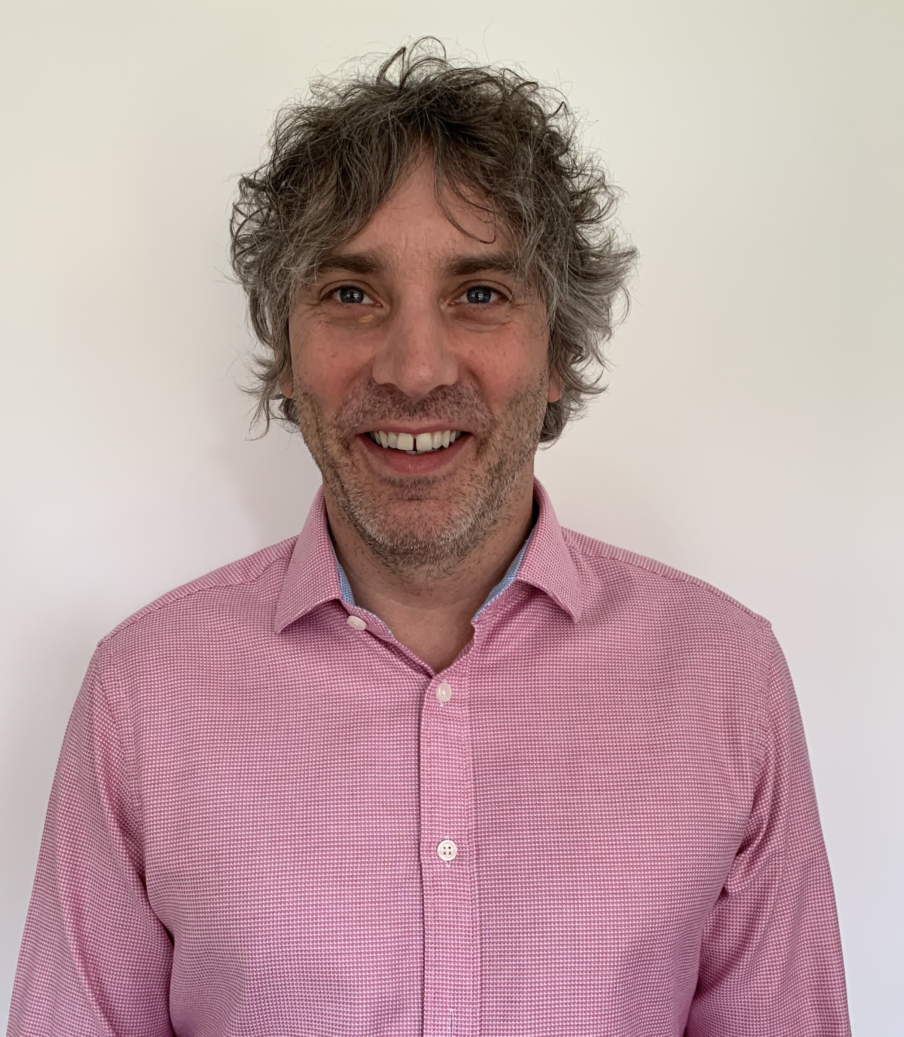
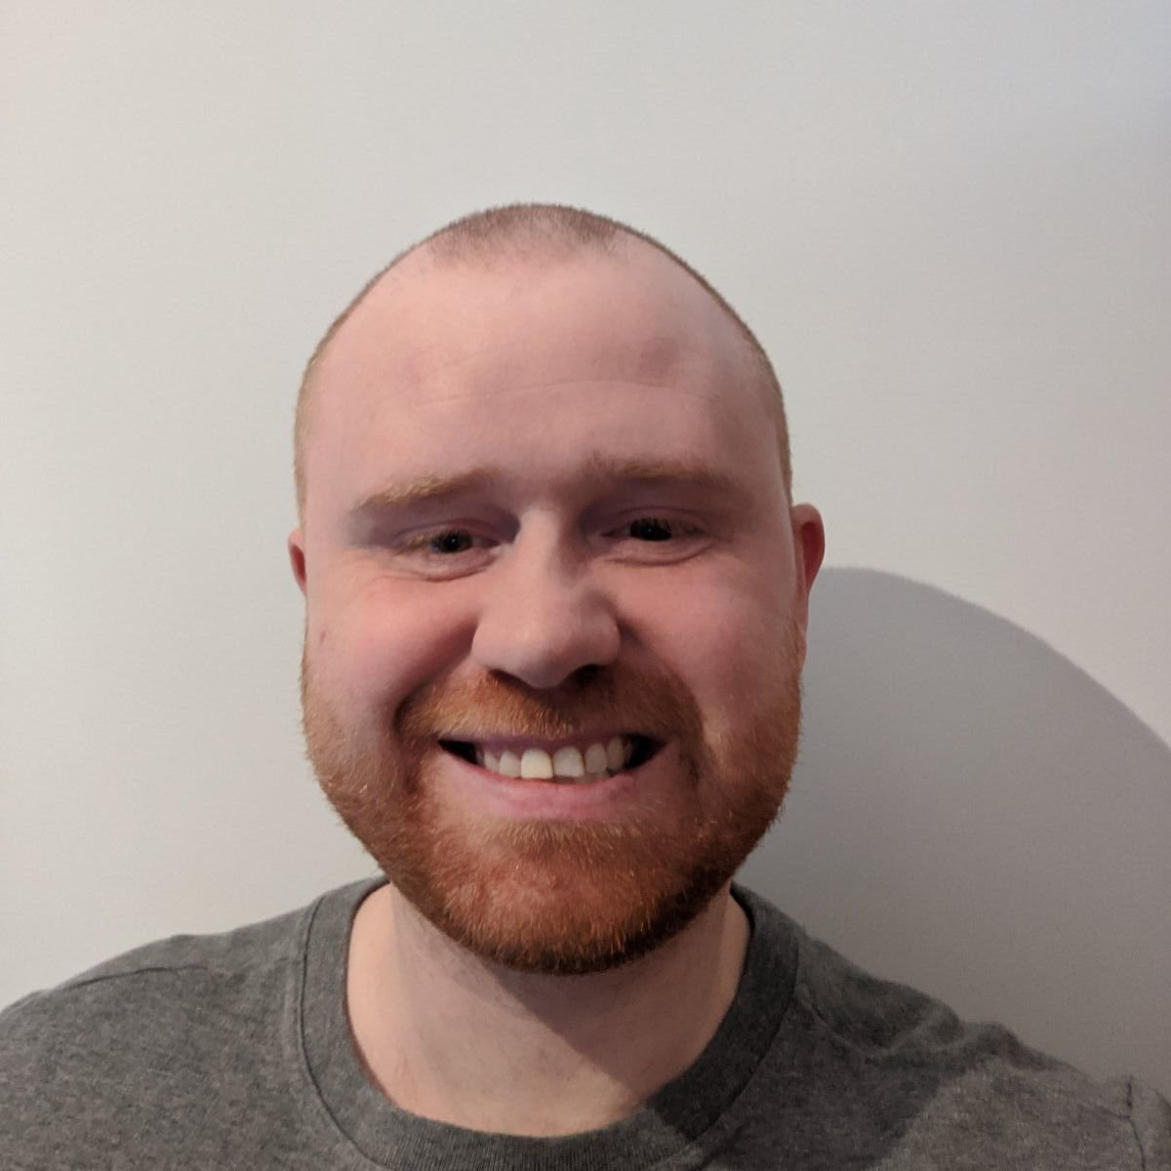
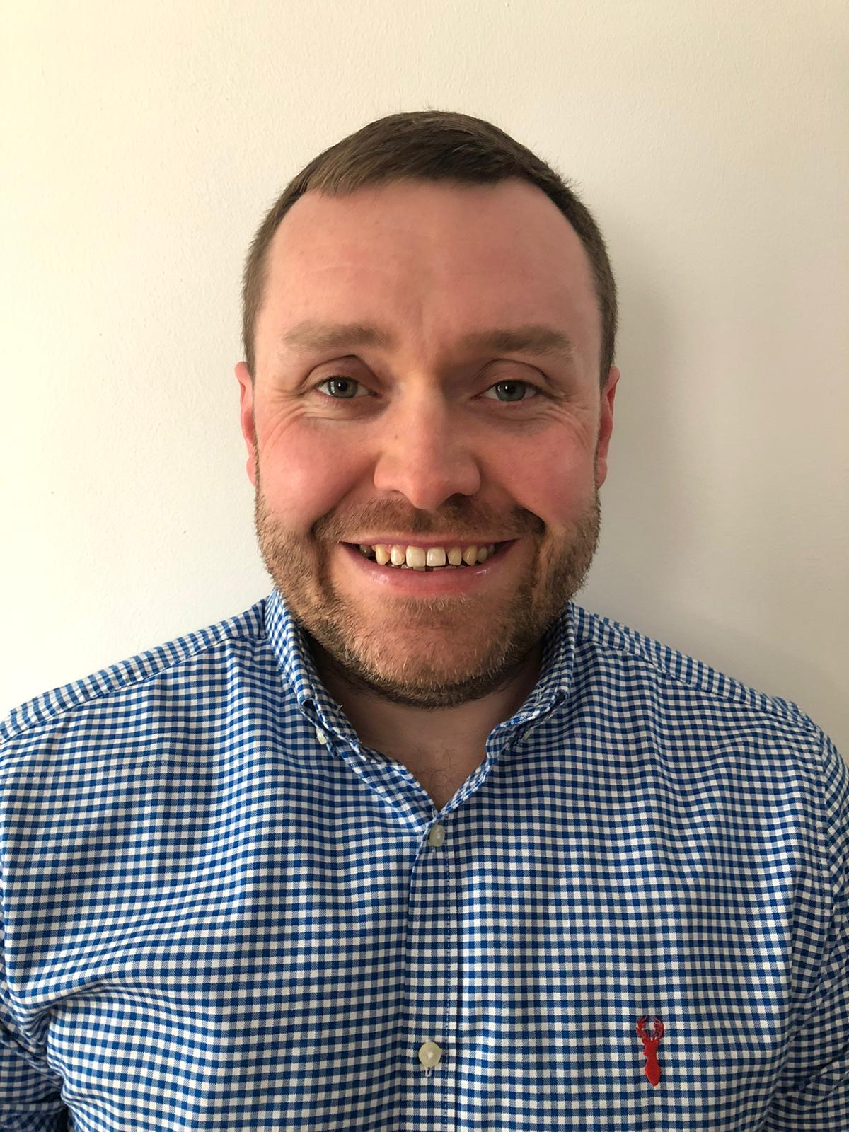
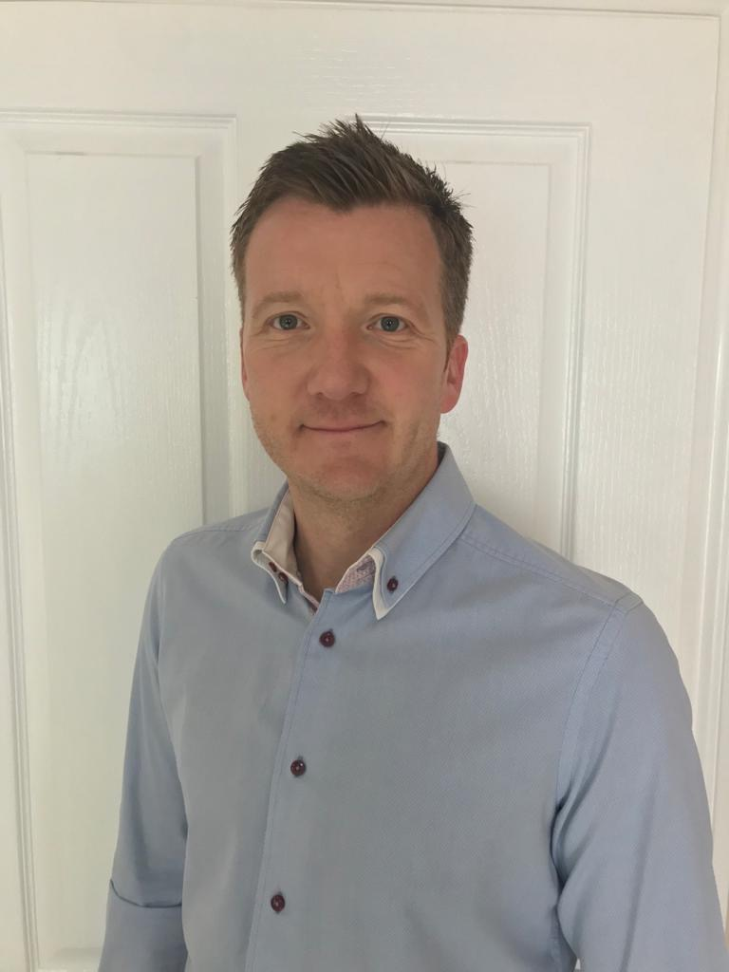
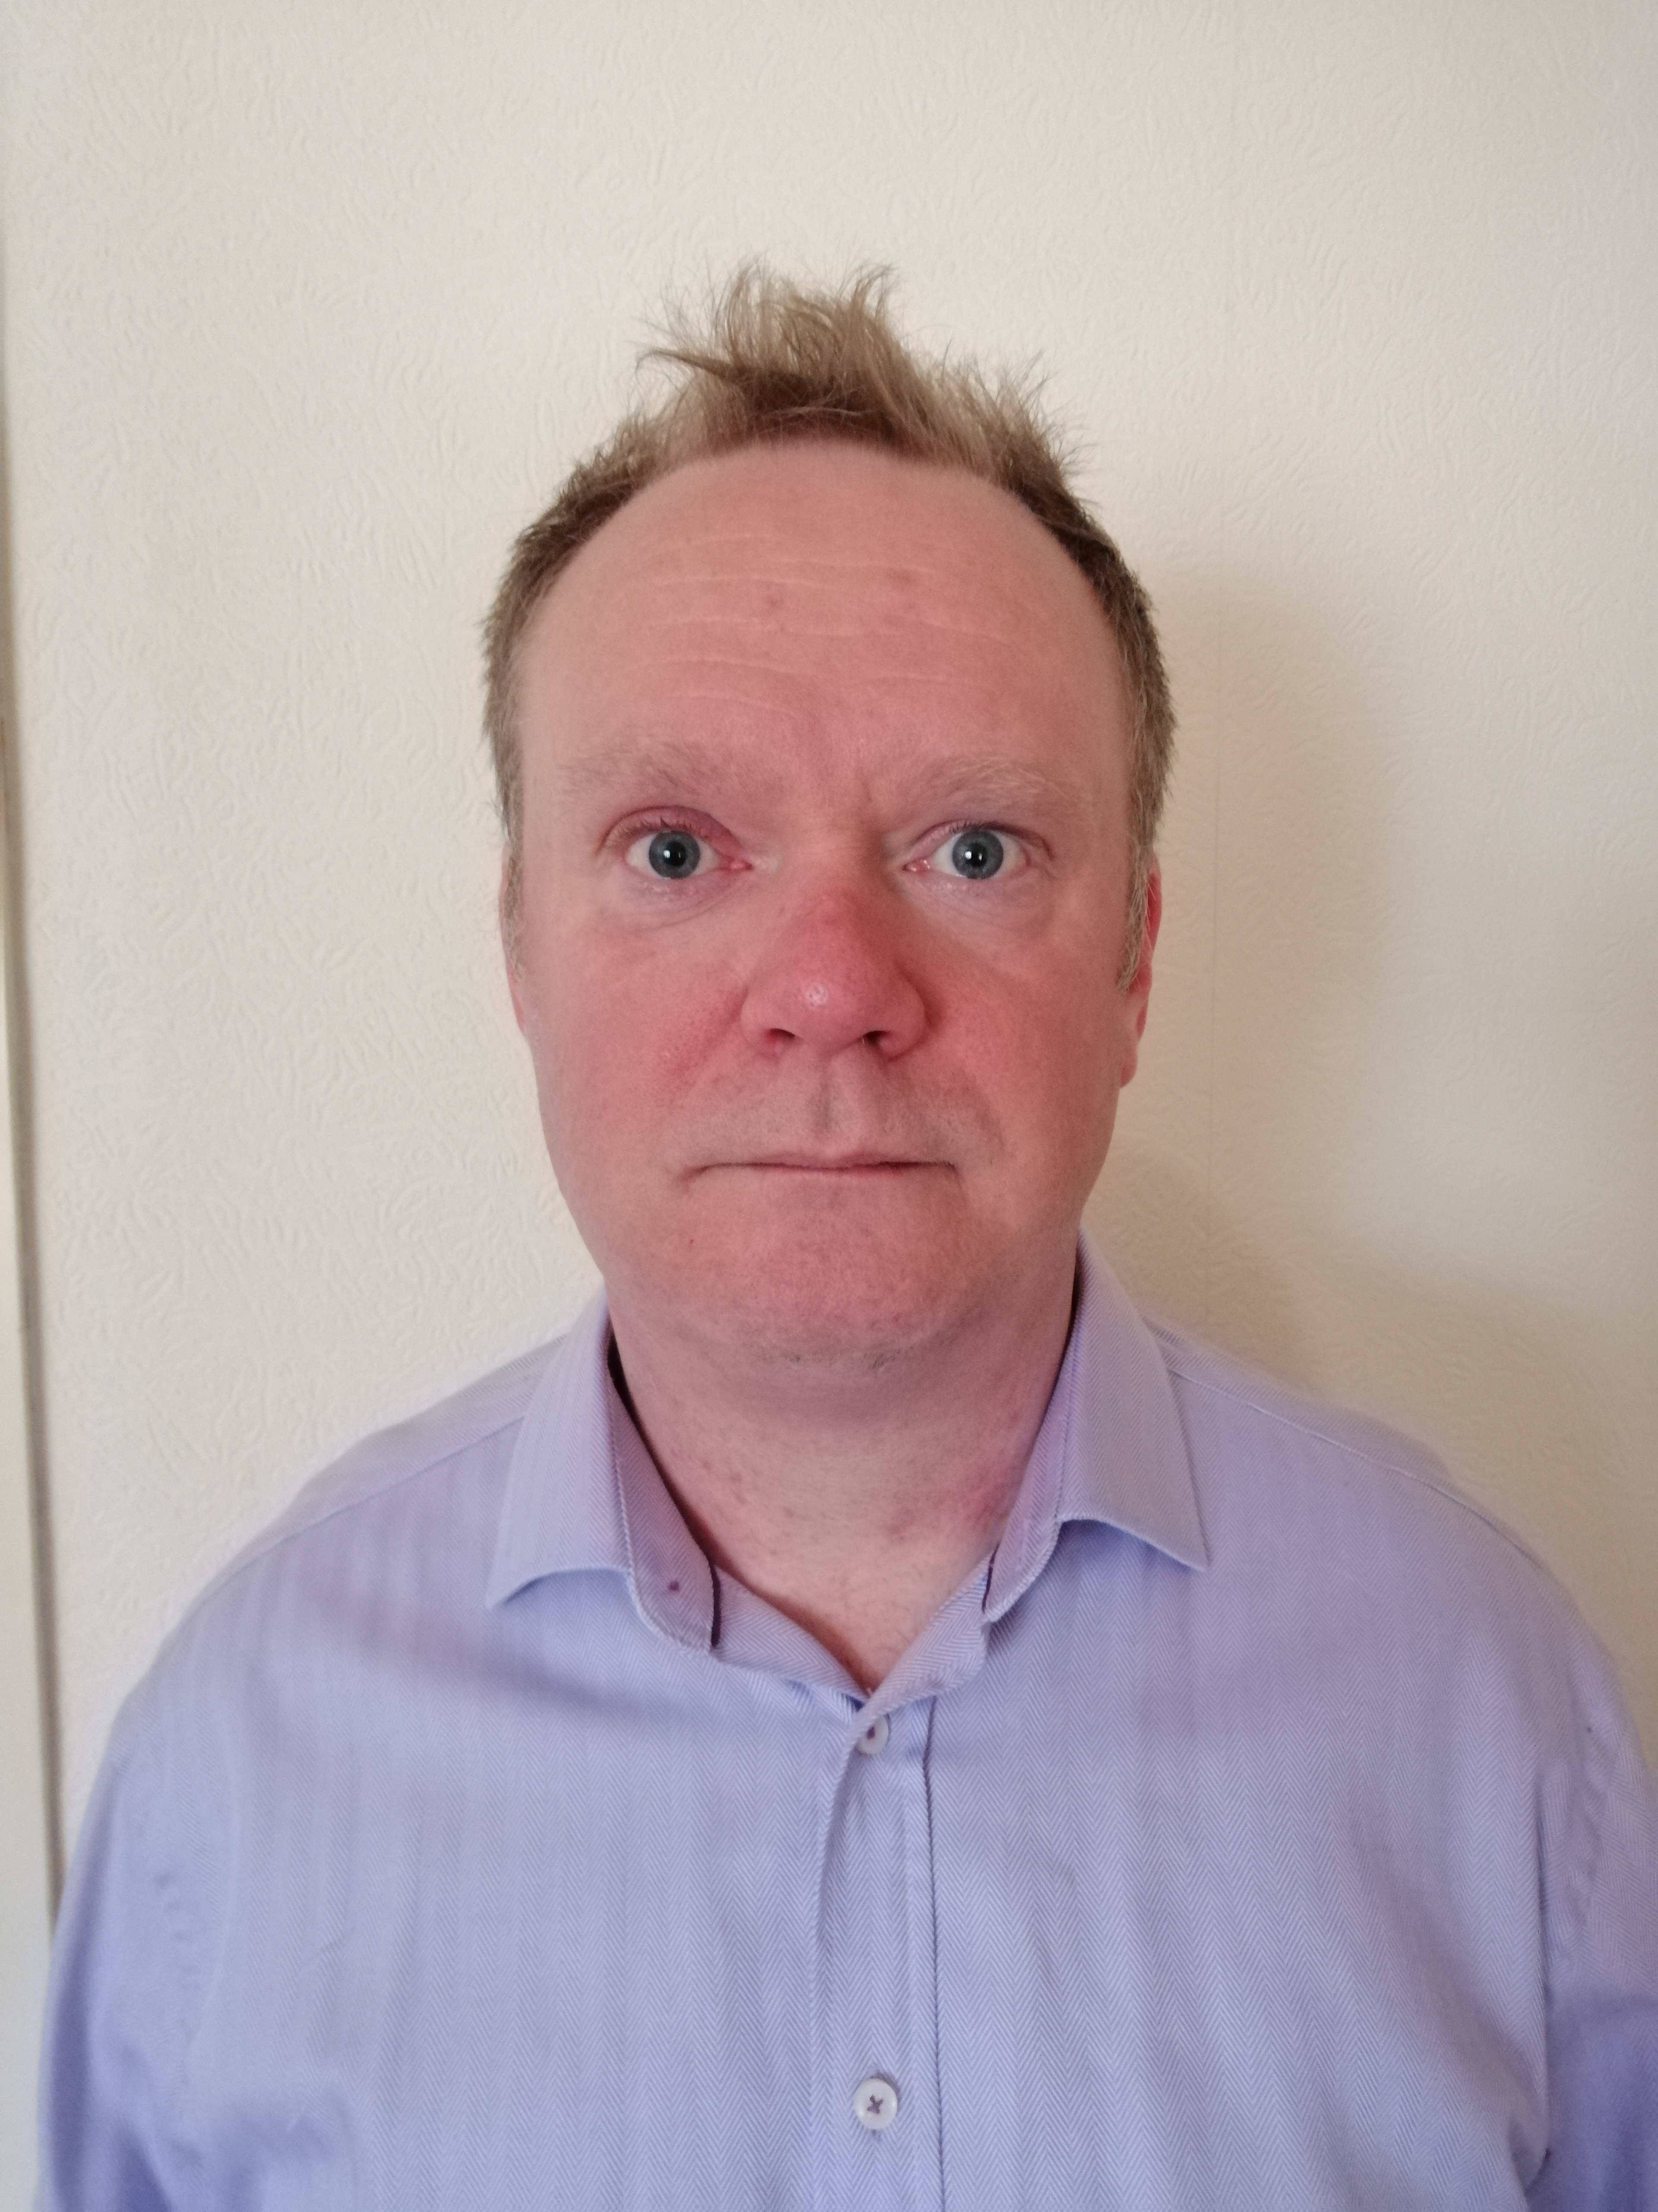
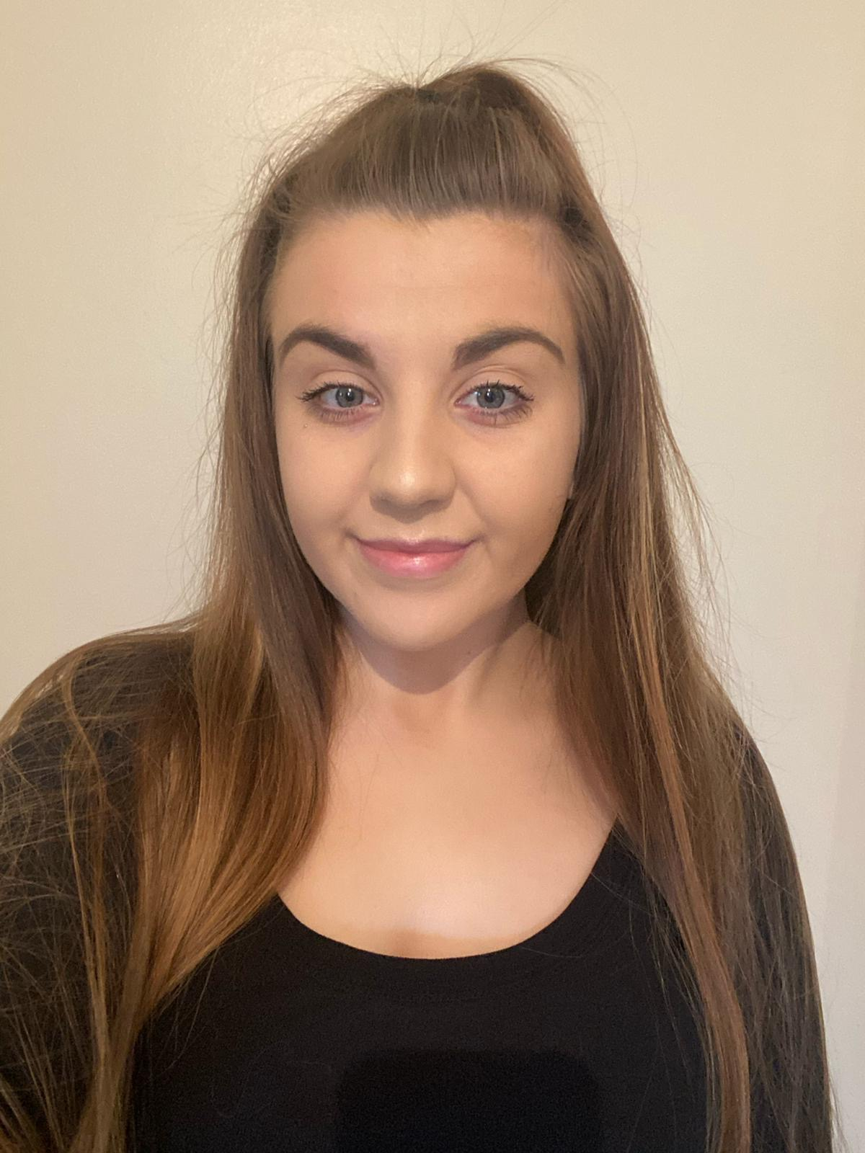
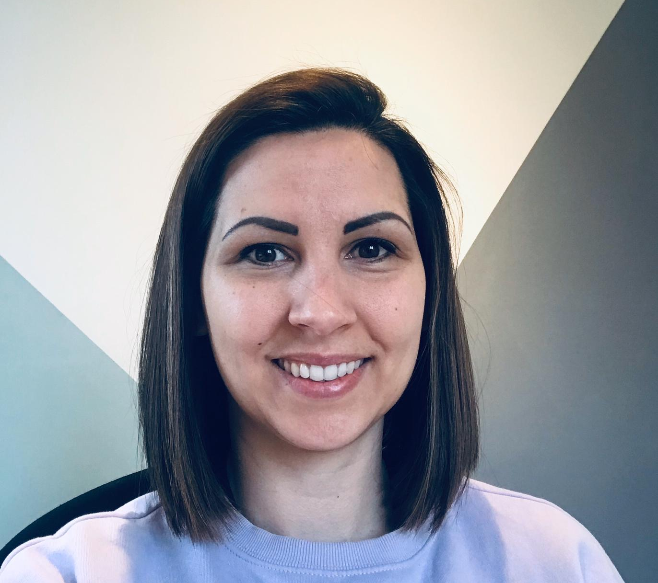
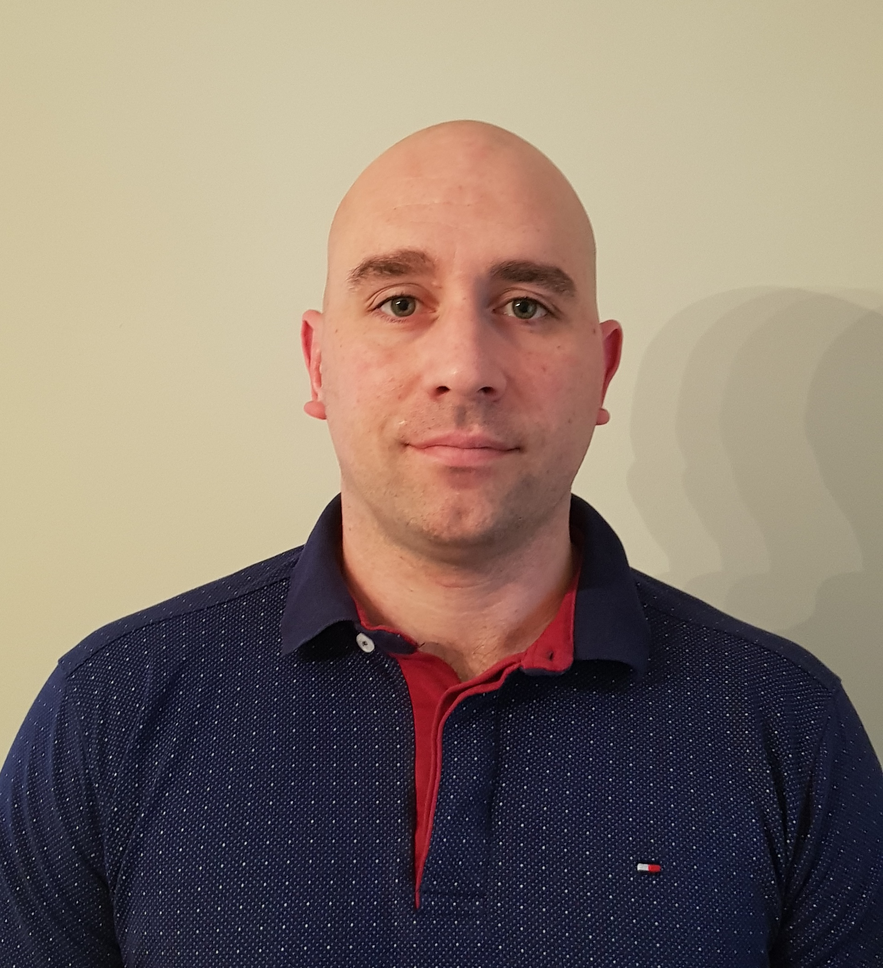
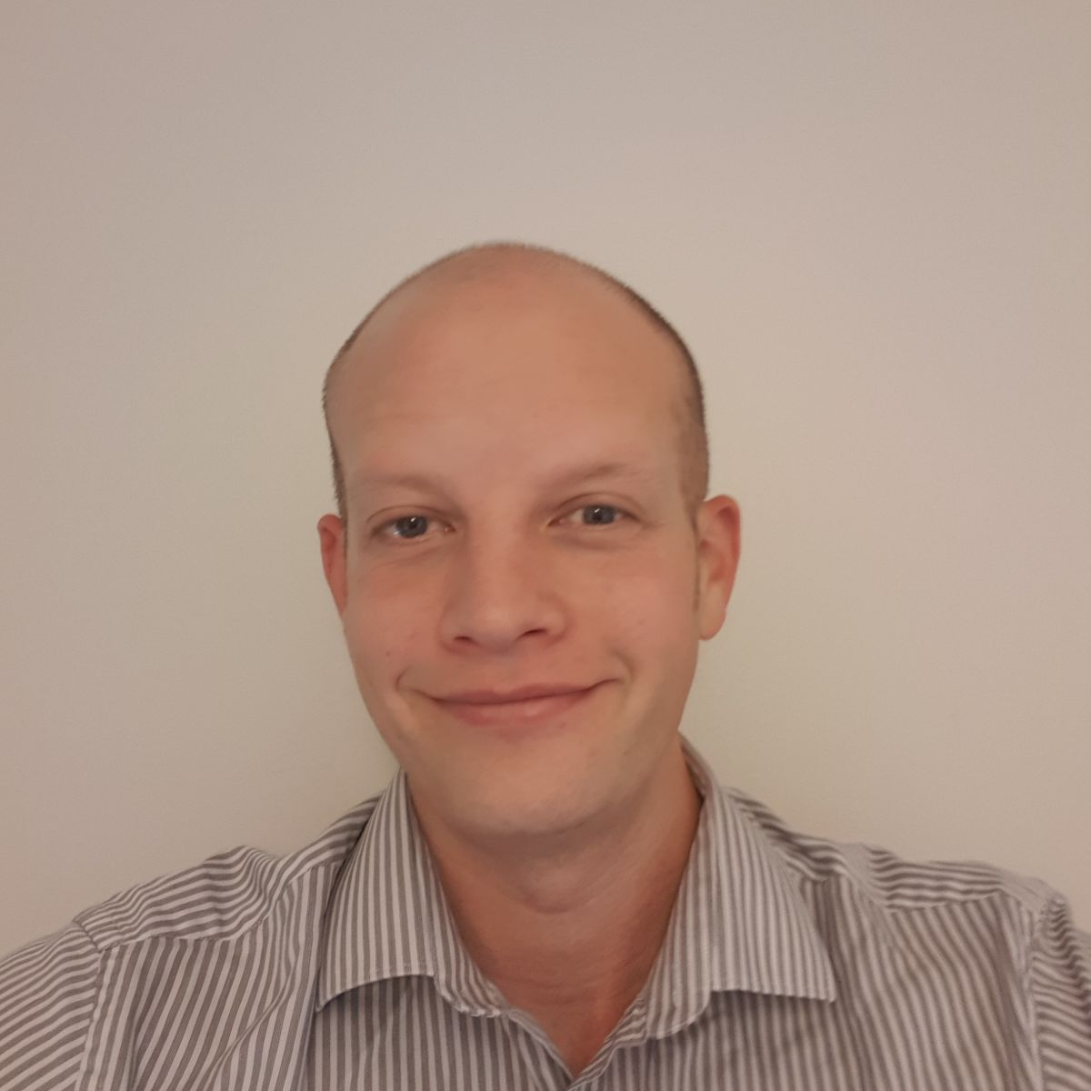
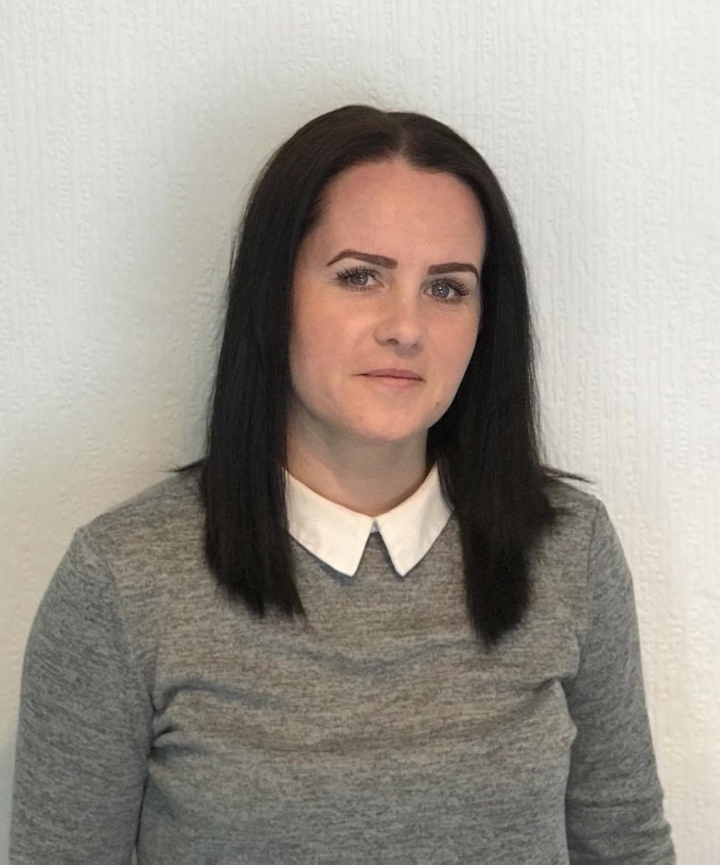
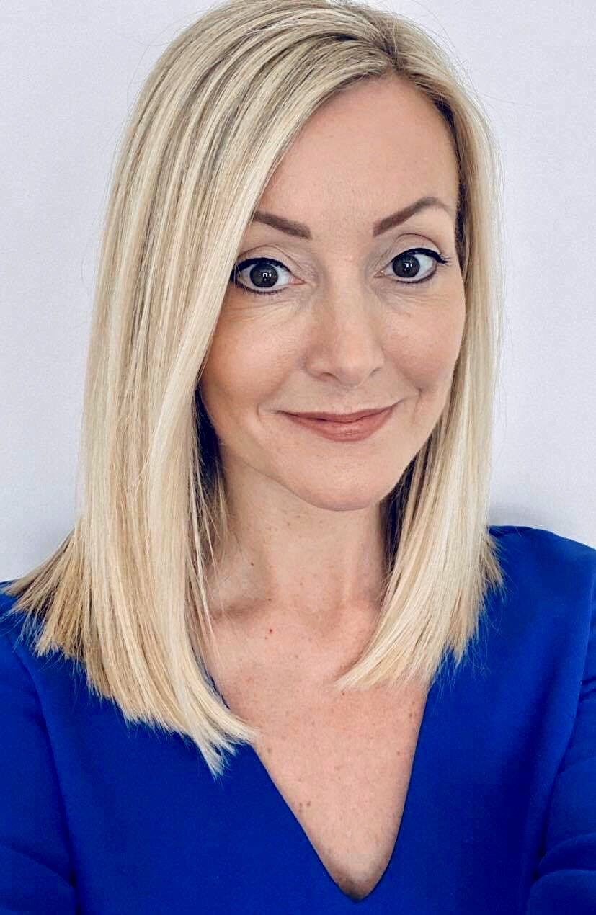
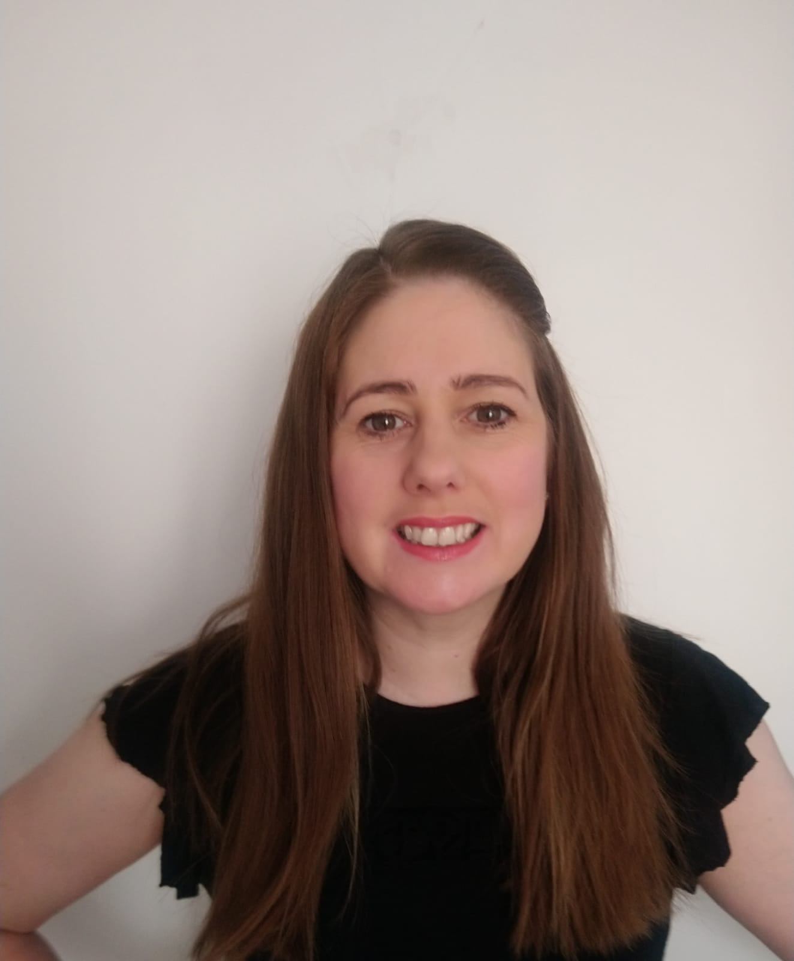
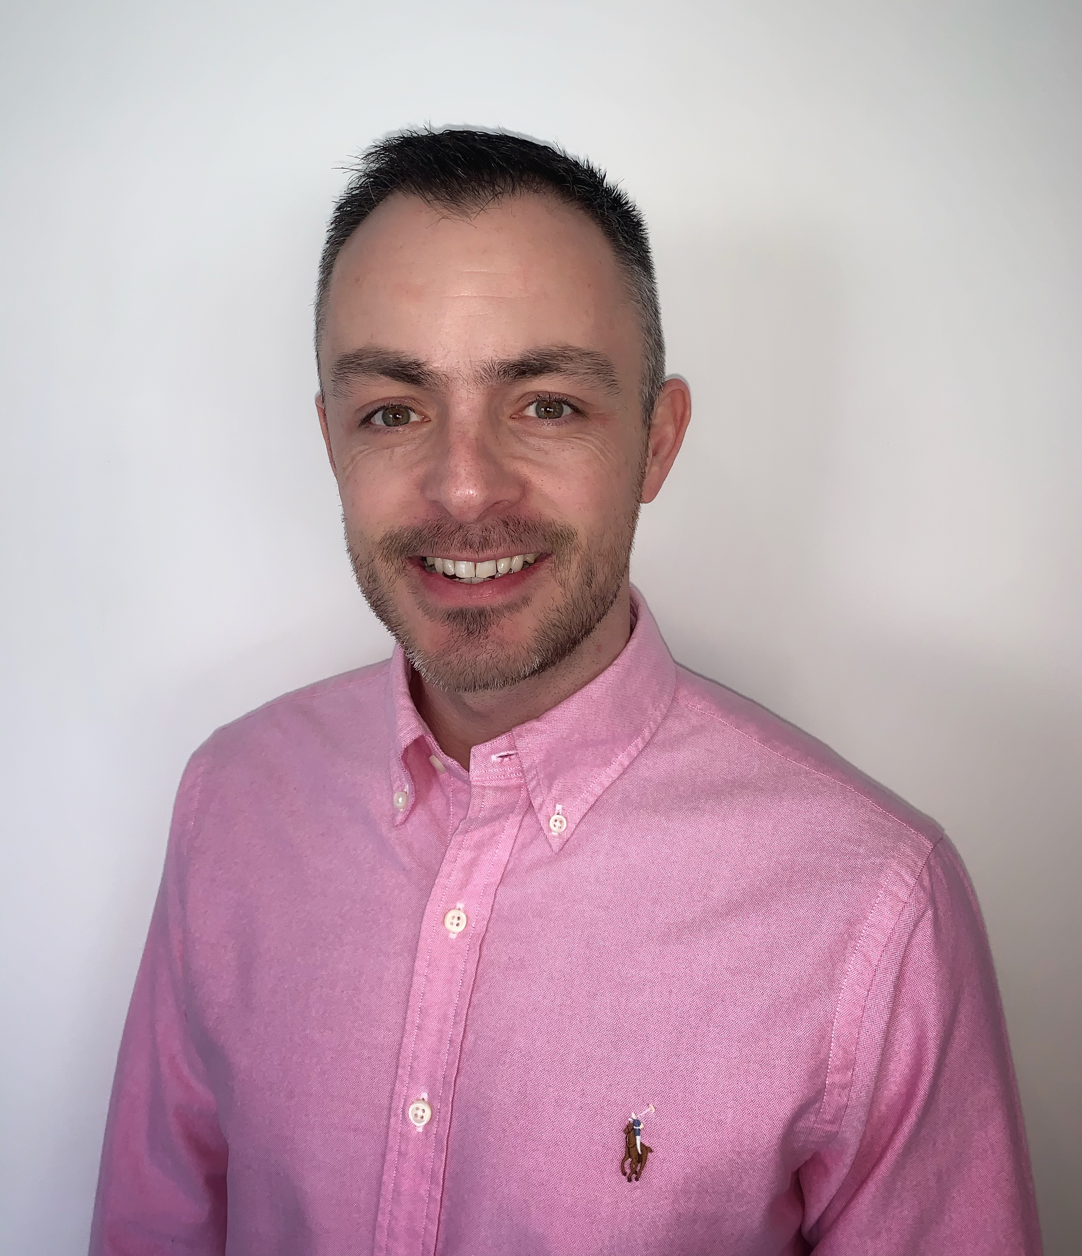
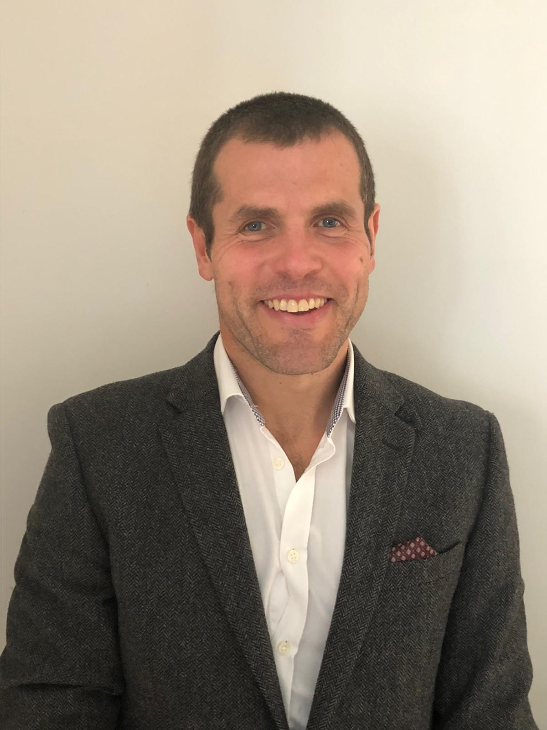
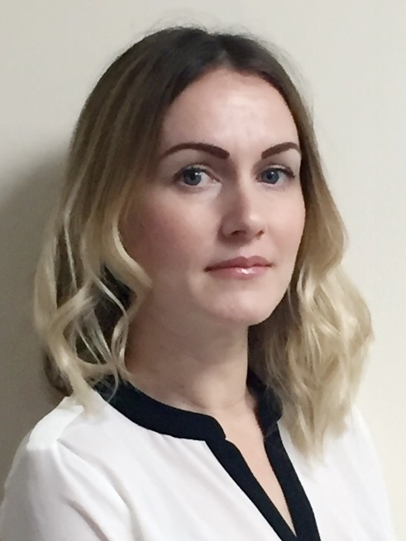
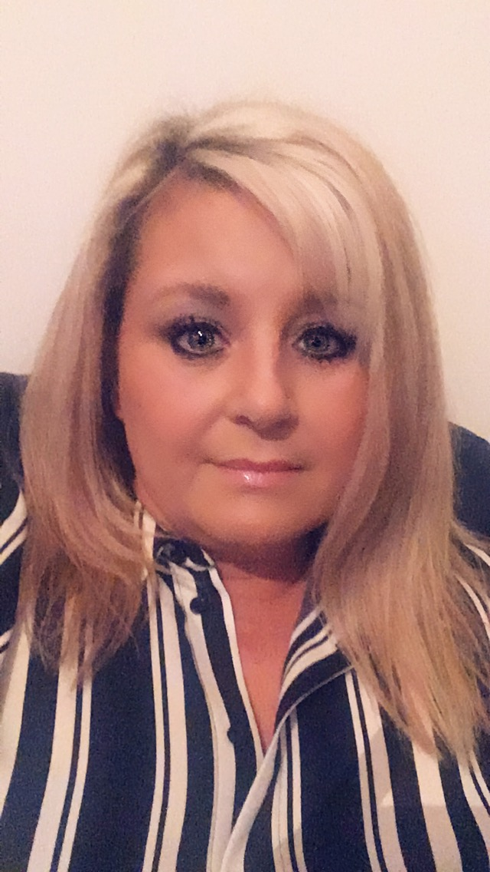
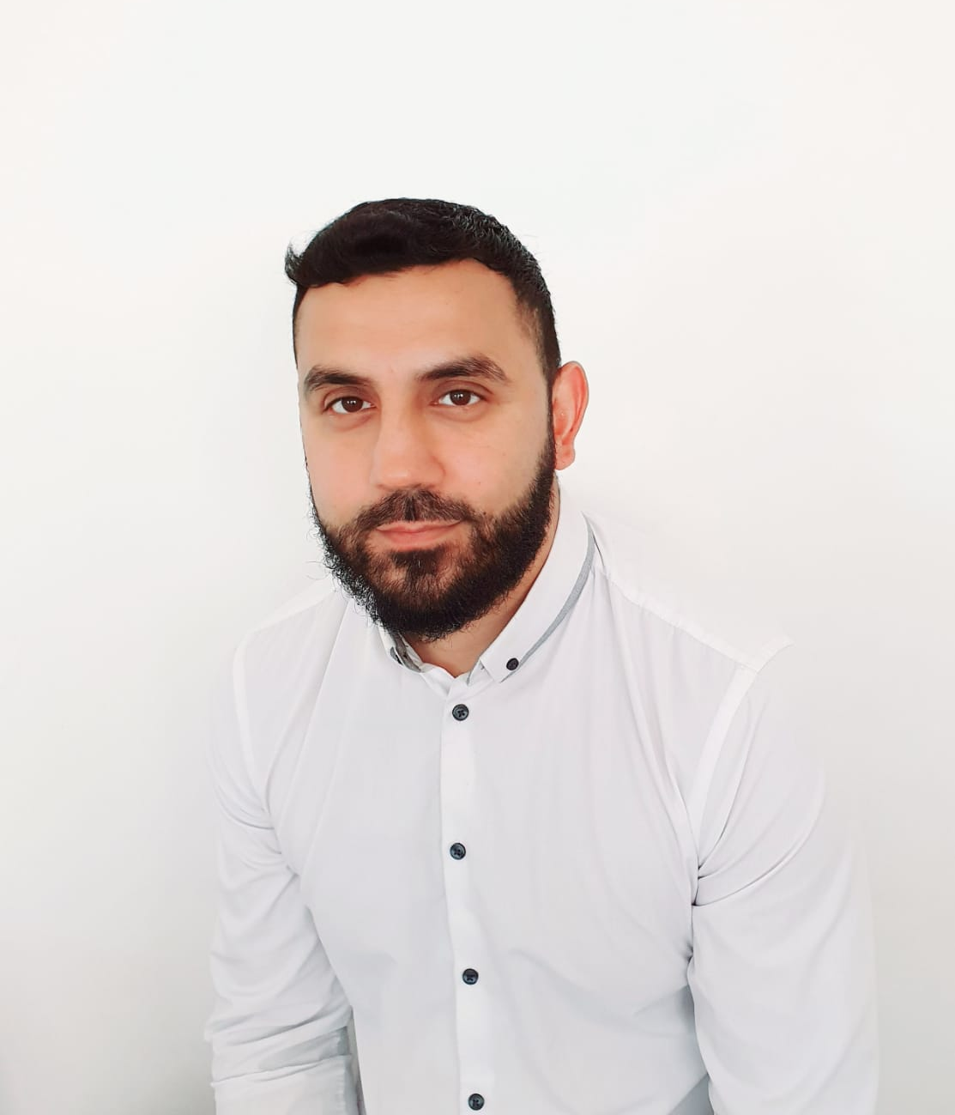
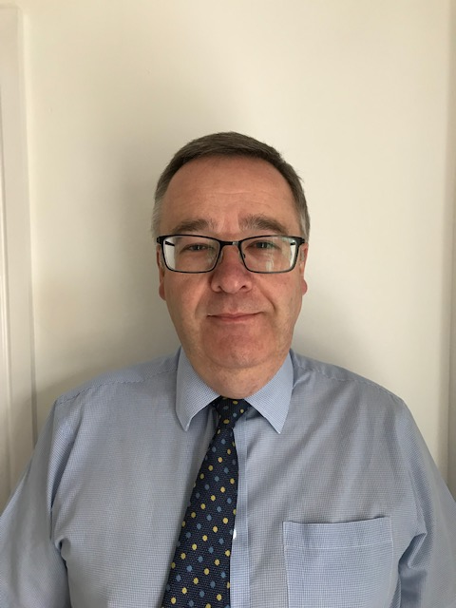
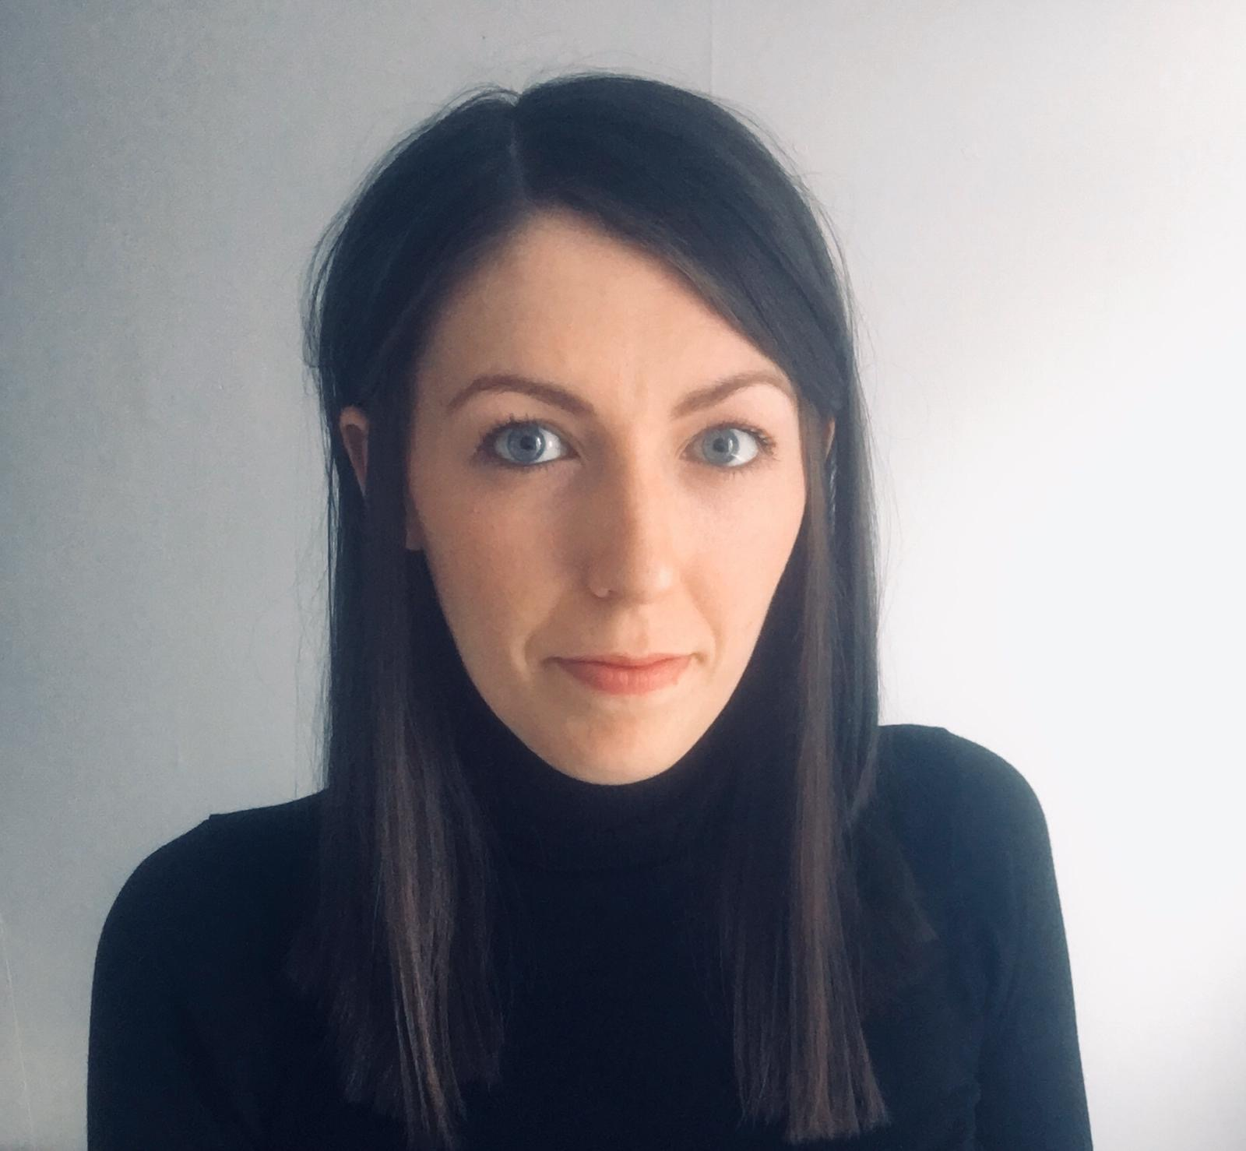

Slide 20

James Smyth
With FC year and half from Intrinsic
Consistently £1,000 pm – targets himself on that every week
Prolific on Social Media
Referrals
Recruits non industry sellers and trains them
Runs the business along with his brother Simon
Positive podcasts etc
Pearls of Wisdom

Slide 21
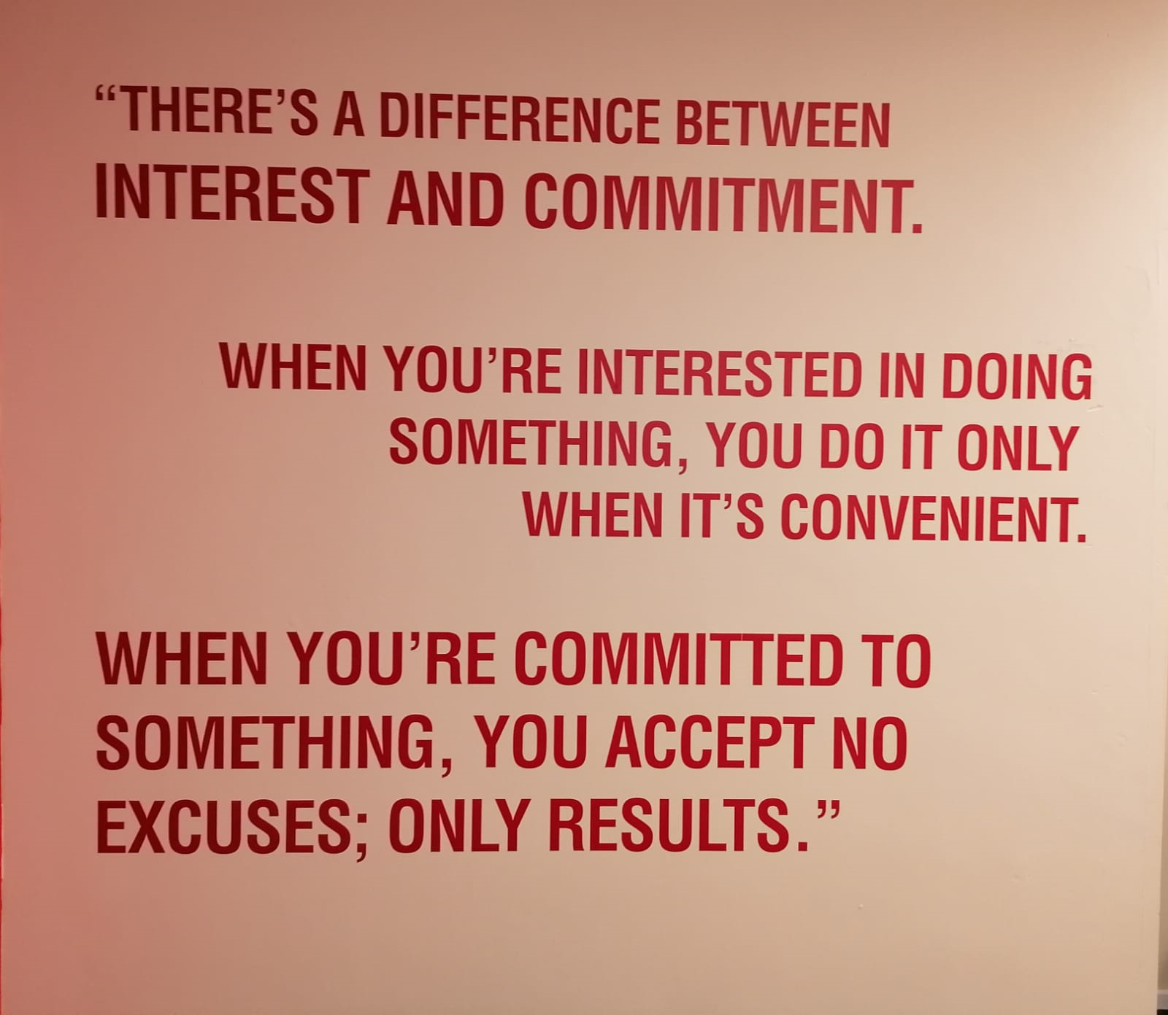

Slide 22
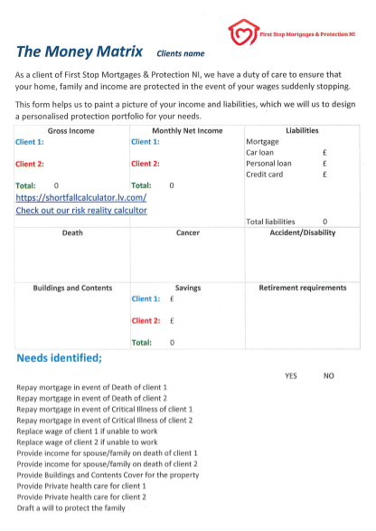

Slide 23
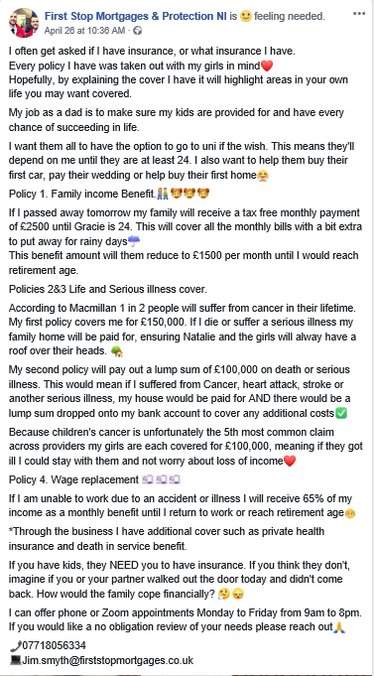
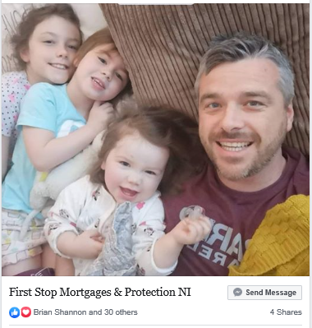
147 enquiries on Facebook alone since lockdown measures were announced in March

Slide 24
  A huge THANK YOU!

Slide 25
  Ring Fencing Clients
Buildings & Contents - Barbed Wire Fence
Trust - Electric Fence
Will - Crocodile Infested Moat
Compulsory Annual Review - CCTV

Slide 26



Slide 27


Questions?

